Slide 1


AI in the Research Lifecycle
https://bit.ly/MSU_AI_Workshop_2025
Link to slides →
Exploring some of the possibilities, pitfalls, and politics
Zoe LeBlanc, Assistant Professor
Contact info:
zleblanc@illinois.edu / zoeleblanc.bsky.social

Slide 2
Terms & Conditions
Generosity & Appreciation
Many thanks to the organizers and all participants 🙏🏽
Also, many thanks the enormous labor and generosity to all the scholars, artists, practitioners, and students working on this topic 👏🏽 👏🏽 👏🏽
Critique as care, not a takedown 🥰
Definitions & Answers
Breadth over depth 🗺️
Very new and fast-moving landscape so hard to be comprehensive or definitive 💨
Positionality & Limitations
Specialize in histories of information & digital humanities & work as a TT prof at an R1 so YMMV 📚
Mostly presenting in this session, so hoping we can discuss more in following sessions 🗣️
PLEASE ASK QUESTIONS & PARTICIPATE 🙋!!

Slide 3
Overview of Workshop Schedule
Directions & Reflections
How are academics using AI, at least so far? What are some of the trends across disciplines? What are our research workflows and lifecycles?
Brainstorming & Exploring
How might AI inform how we develop research questions and projects? How can we effectively use chatbots and how much do we need to understand AI?
Collecting & Curating
How can AI help us collect and curate our research materials? How does AI fit with other existing scholarly infrastructures?
Designing & Analyzing
How can we utilize AI to design our research and learn new methods? How can AI also help us analyze our results? How much can we trust AI?
Evaluating & Preserving
How can we develop practices that support reproducible and sustainable research with AI? How can we ensure that our practices are in line with our political and ethical values?

Slide 4
Part 1 Some Initial Directions & Reflections To Ground Our Use of AI in Research

Slide 5
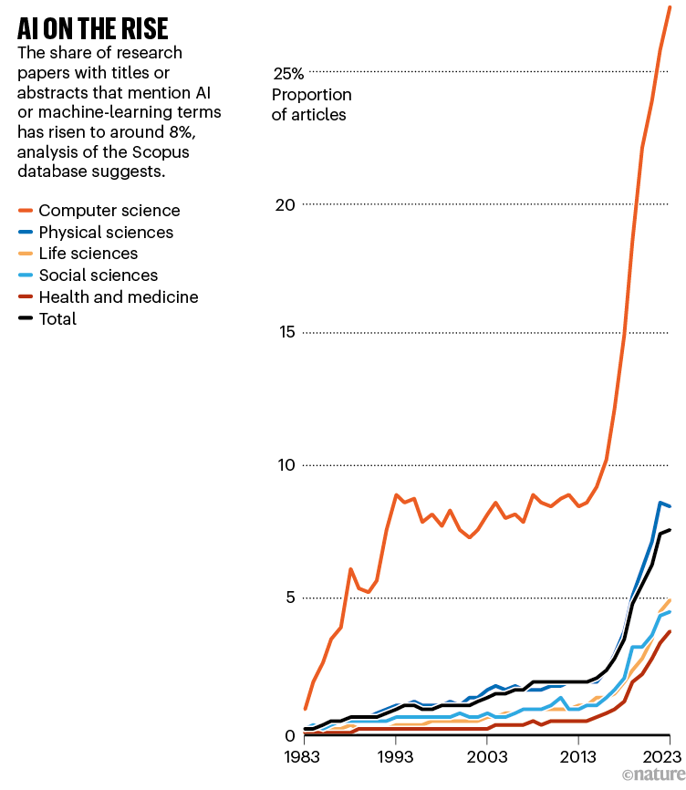
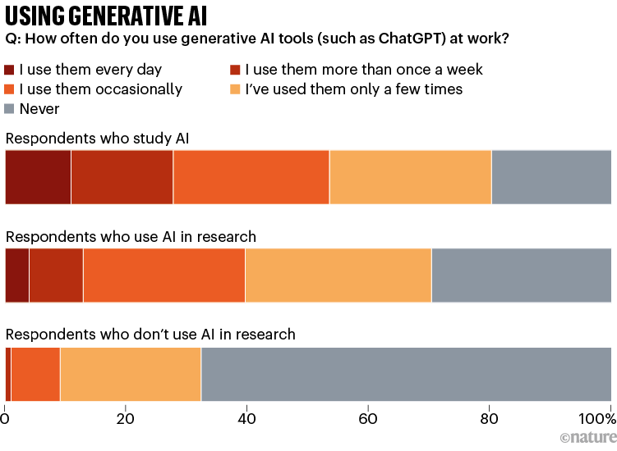
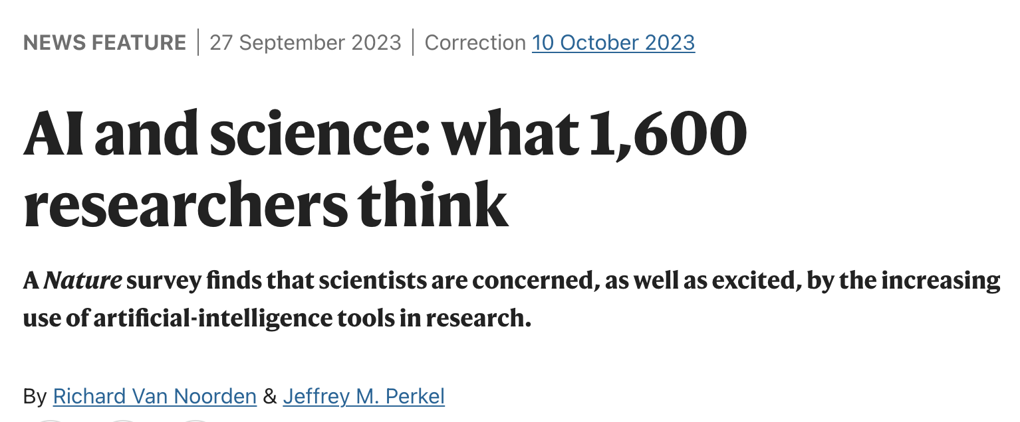
Initial Findings on AI & STEM

Slide 6
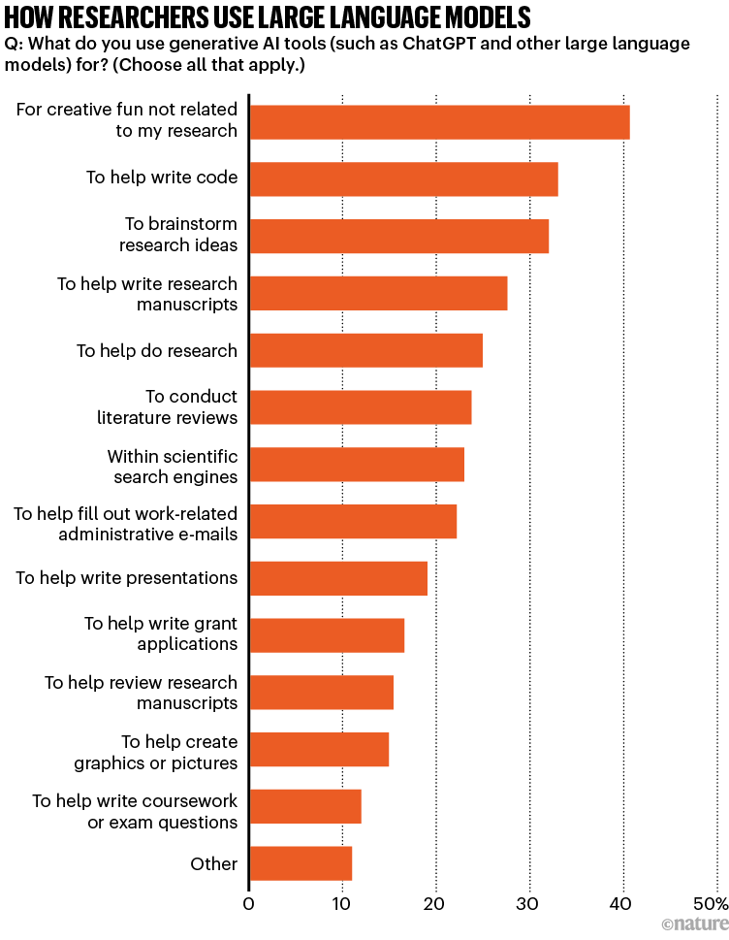
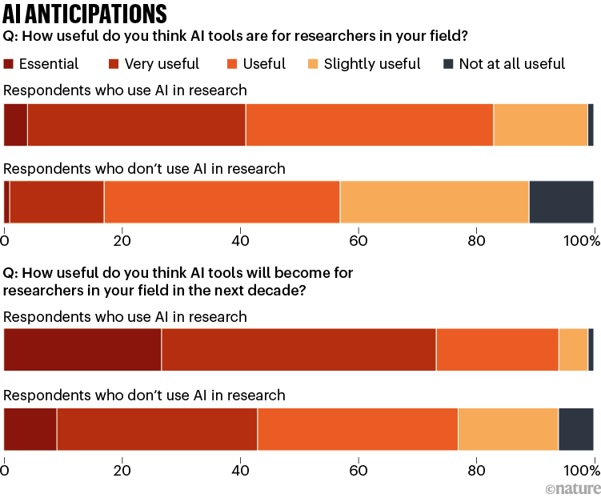
Initial Findings on AI & STEM

Slide 7
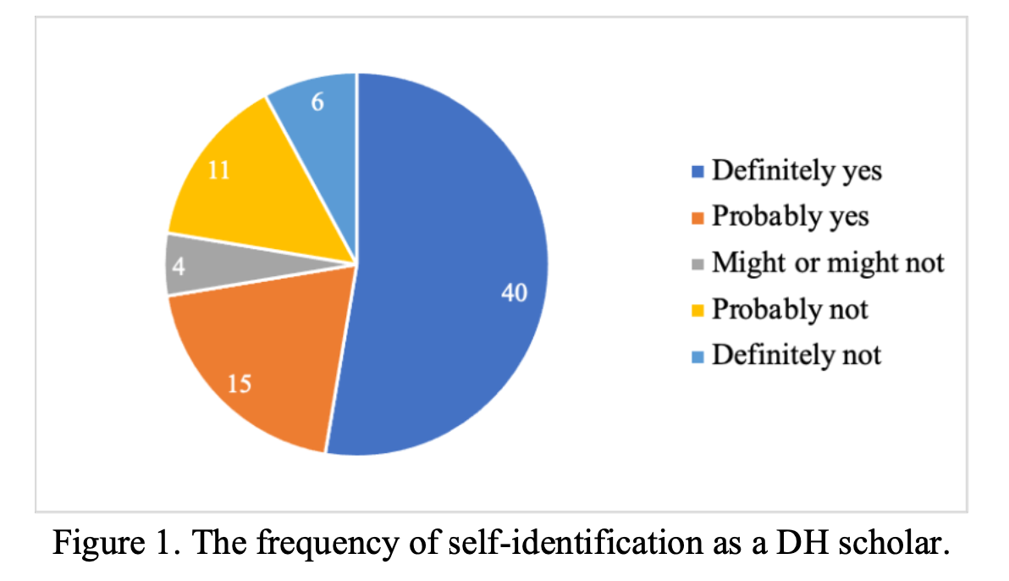
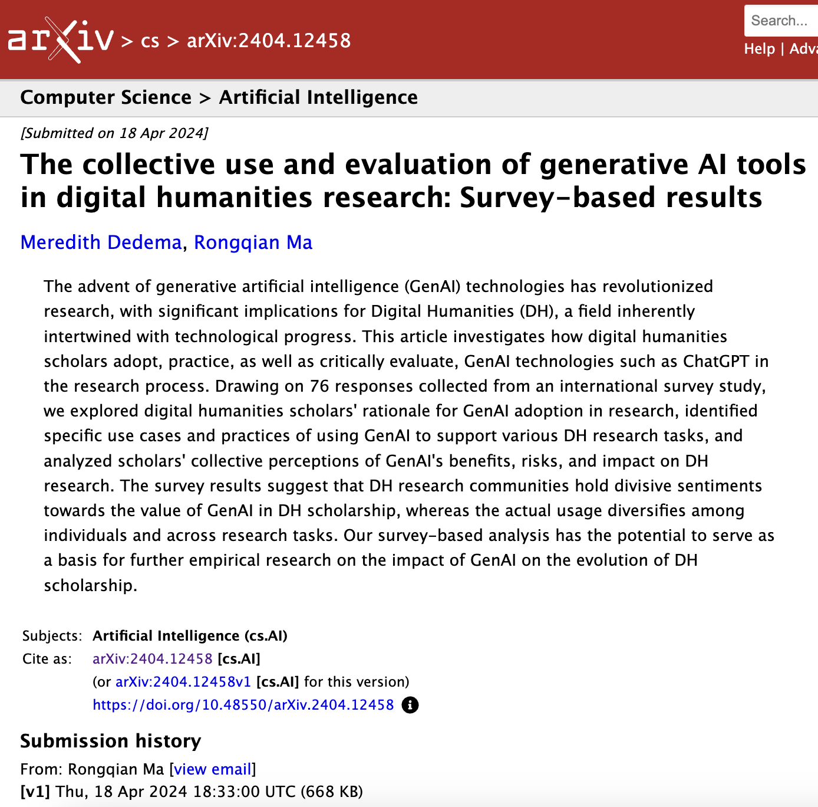
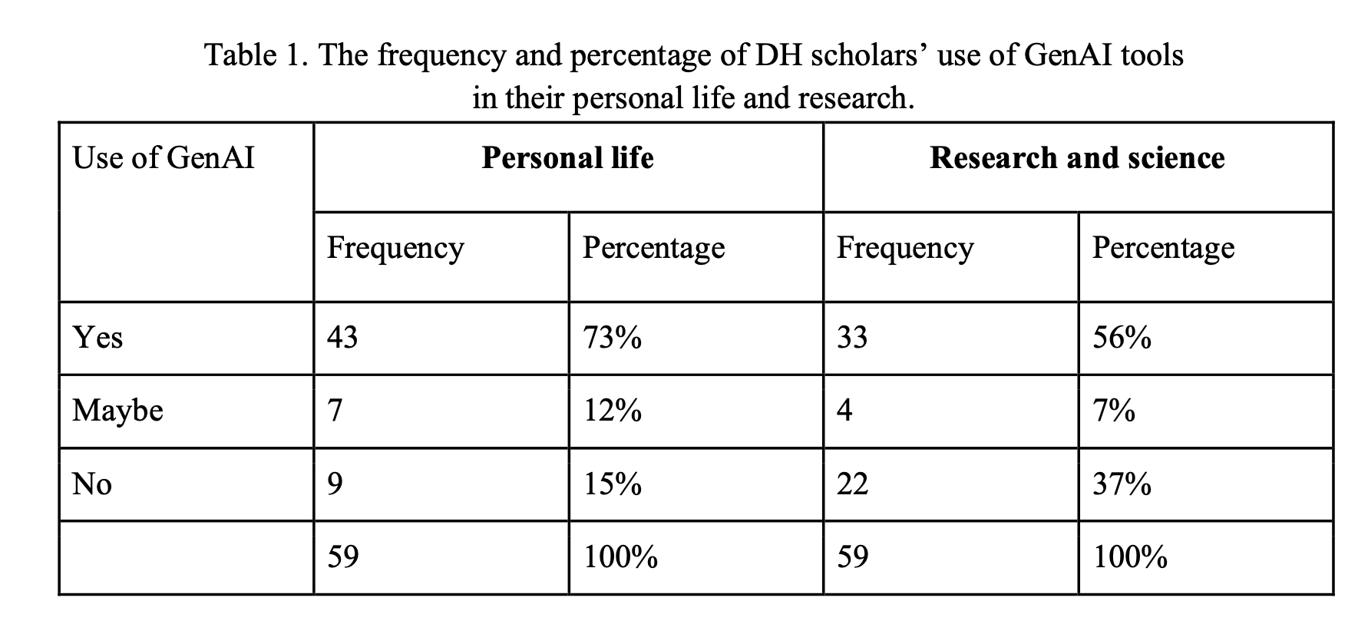
Initial Findings on AI & (Digital) Humanities

Slide 8
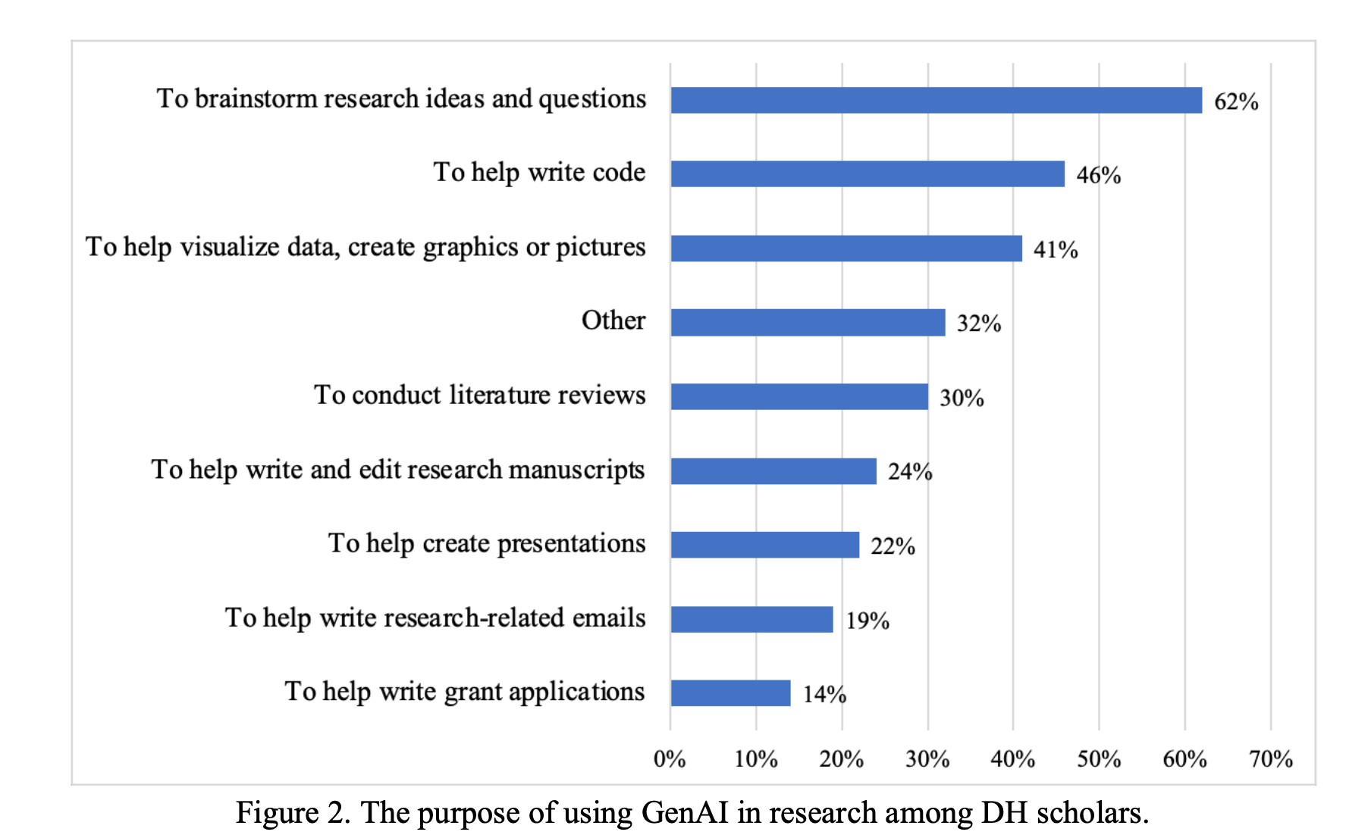
Initial Findings on AI & (Digital) Humanities

Slide 9
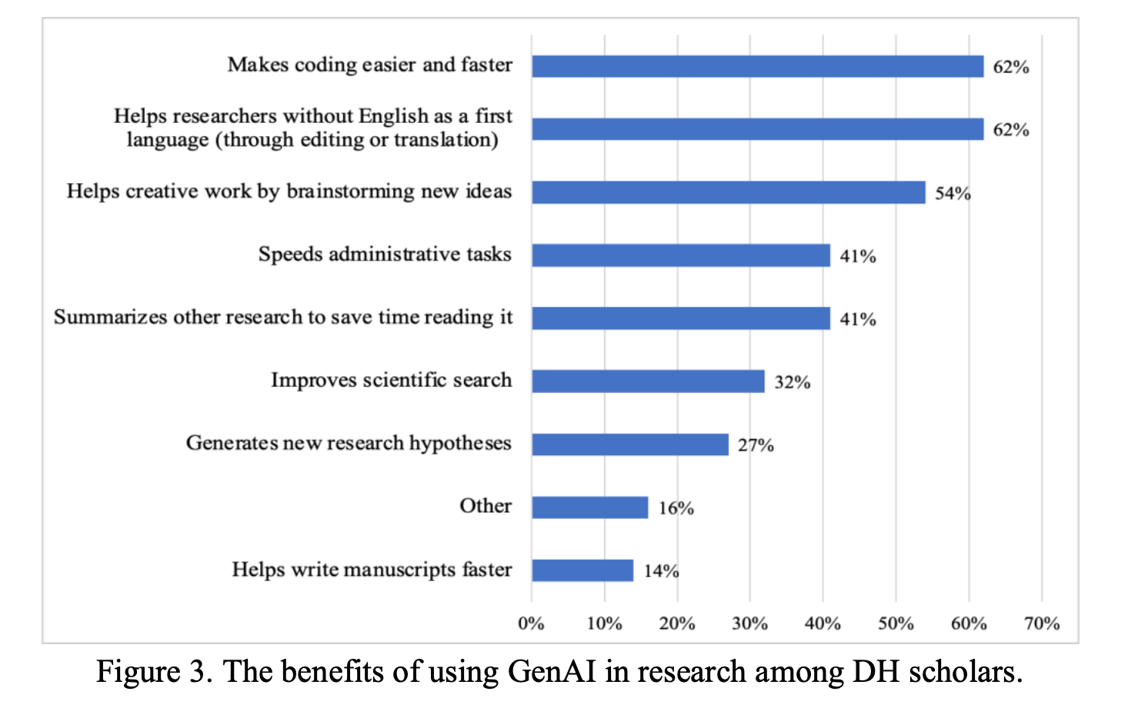
Initial Findings on AI & (Digital) Humanities

Slide 10
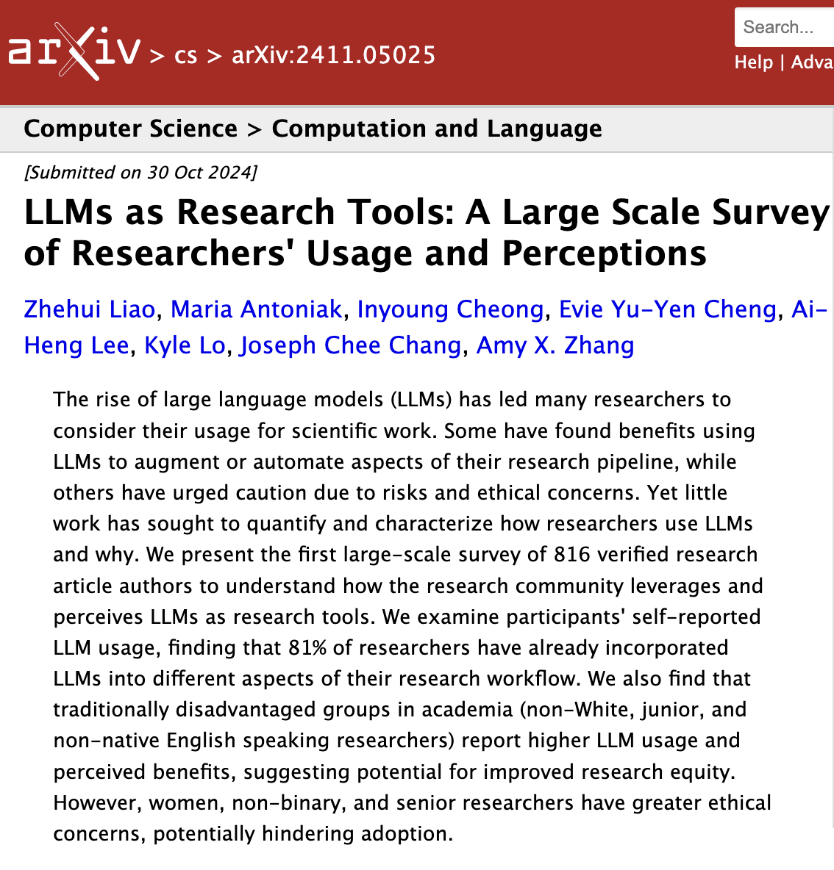
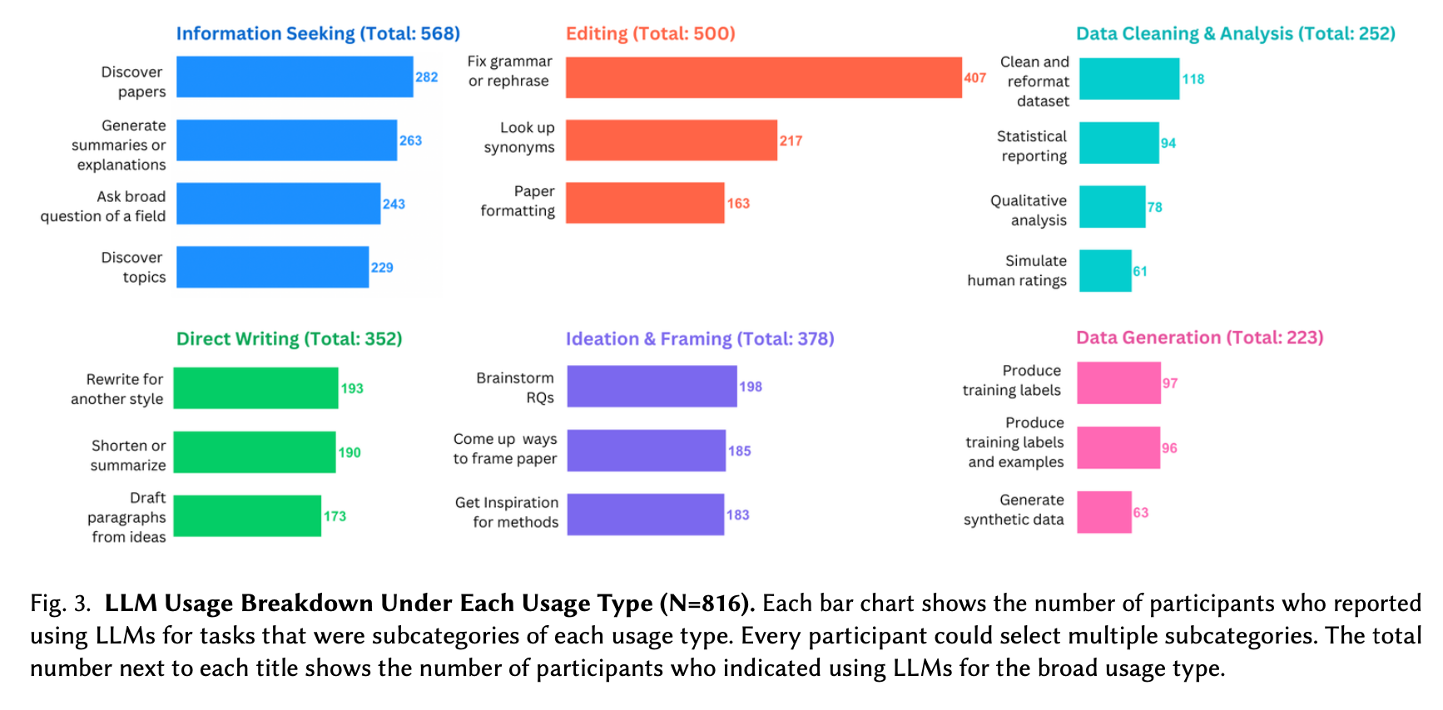
Initial Findings on AI & Stem/Social Sciences

Slide 11
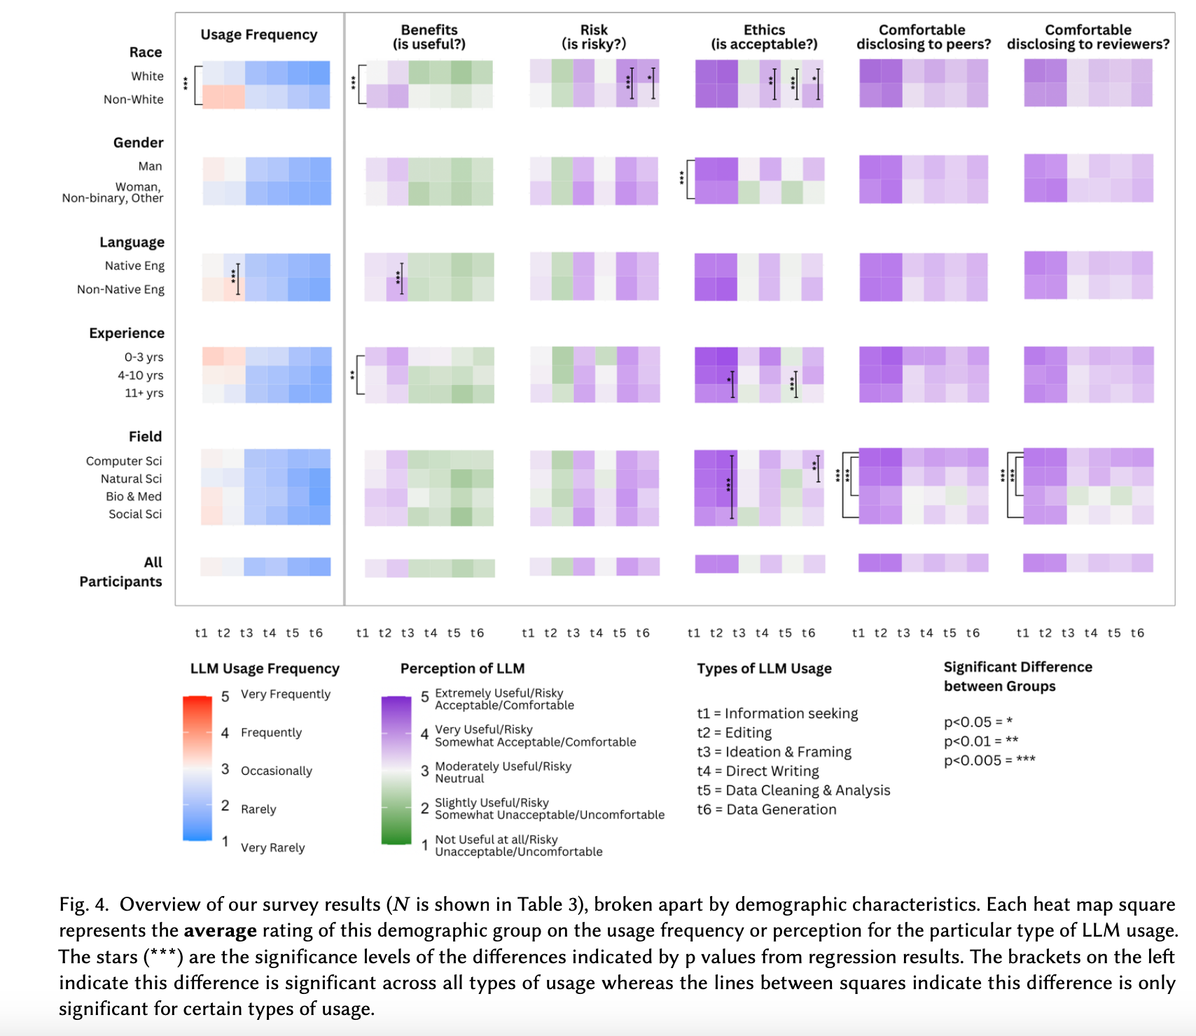
Initial Findings on AI & Stem/Social Sciences

Slide 12
What are some the emerging trends around how academics are using AI?
ADDITIONAL SELECTED RESOURCES:
Gefen, Alexandre, Léa Saint-Raymond, and Tommaso Venturini. “AI for Digital Humanities and Computational Social Sciences.” In Reflections on Artificial Intelligence for Humanity, edited by Bertrand Braunschweig and Malik Ghallab, 191–202. Cham: Springer International Publishing, 2021. https://doi.org/10.1007/978-3-030-69128-8_12. Explores how AI methodologies can bridge digital humanities and computational social sciences.
Ziems, Caleb, William Held, Omar Shaikh, Jiaao Chen, Zhehao Zhang, and Diyi Yang. “Can Large Language Models Transform Computational Social Science?” arXiv, February 26, 2024. https://doi.org/10.48550/arXiv.2305.03514. Investigates the transformative potential of large language models in computational social science research.
Bail, Christopher A. “Can Generative AI Improve Social Science?” Proceedings of the National Academy of Sciences 121, no. 21 (May 21, 2024): e2314021121. https://doi.org/10.1073/pnas.2314021121. Assesses the capacity of generative AI to advance social science research and methods.
Hoffmann, Manuel, Sam Boysel, Frank Nagle, Sida Peng, and Kevin Xu. “Generative AI and the Nature of Work.” SSRN Scholarly Paper. Rochester, NY: Social Science Research Network, October 27, 2024. https://doi.org/10.2139/ssrn.5007084. Examines how generative AI could reshape work processes and job roles, analyzing future labor implications.
What additional research have you found useful? Do these results fit with your experiences?

Slide 13
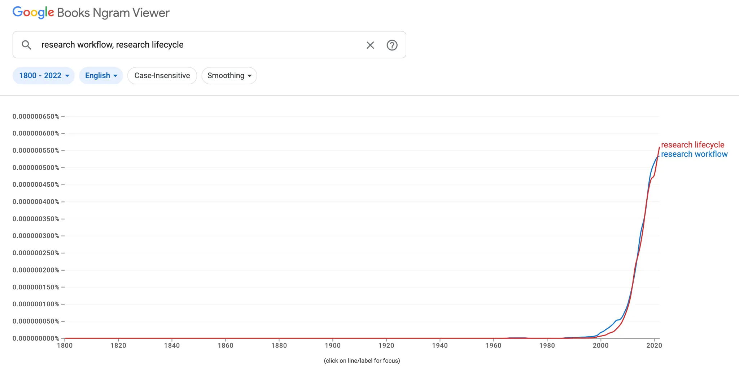
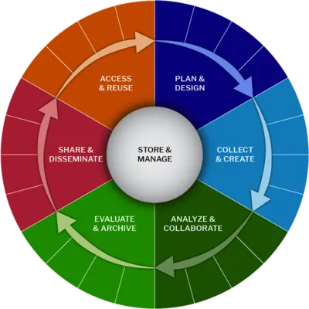
Research Lifecycles & Workflows in Academia
How much do you intentionally use existing research workflows versus tailor to your needs?

Slide 14
Part 2 Brainstorming & Exploring Research Questions with AI
How do we begin integrating AI into our research workflows?

Slide 15
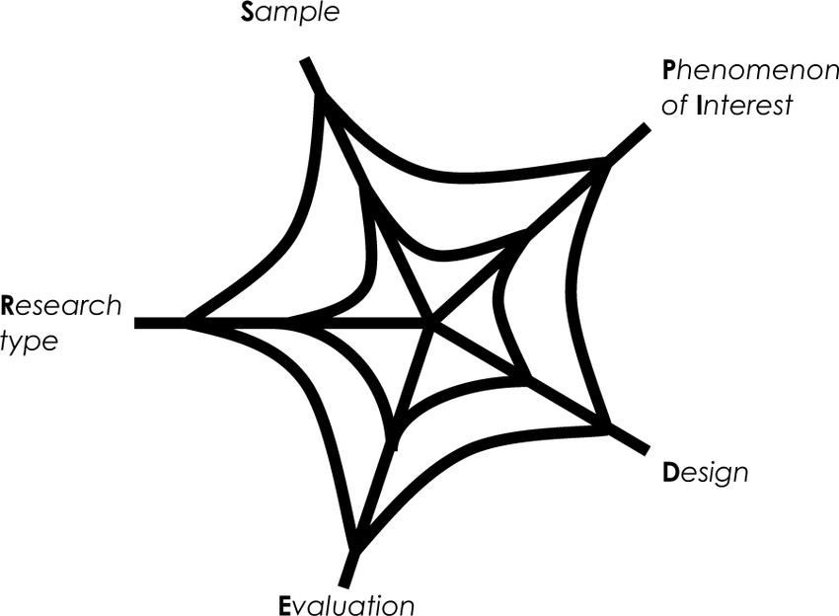
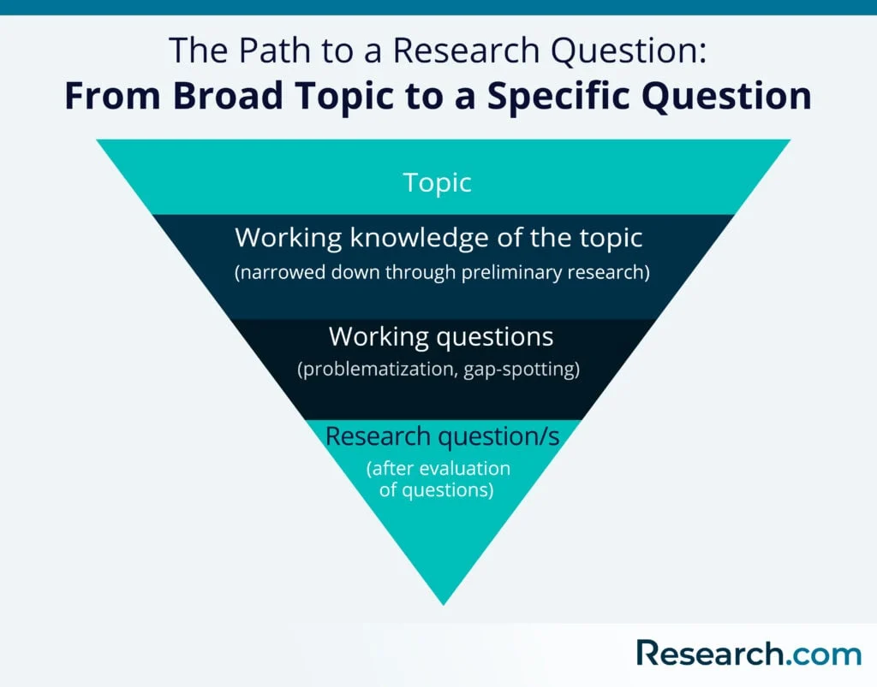
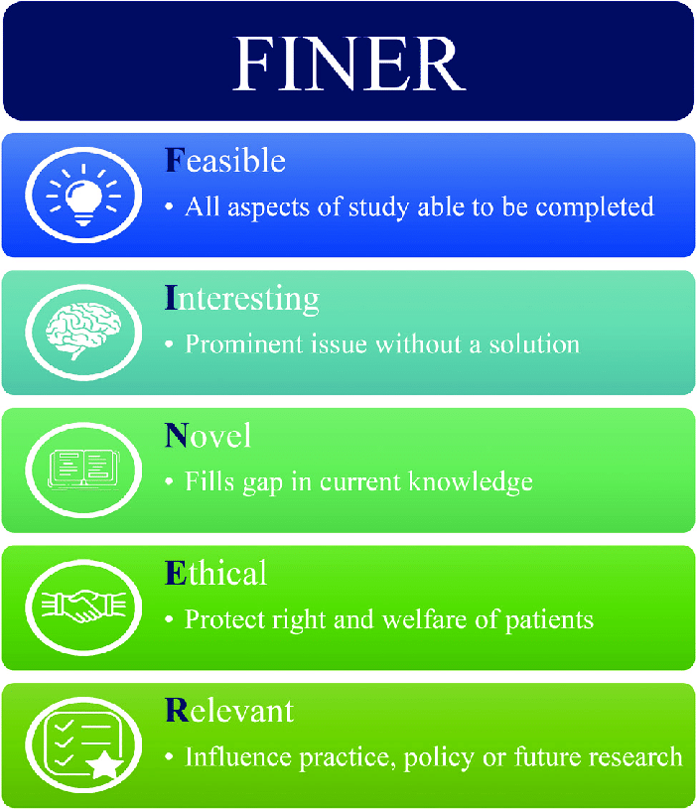
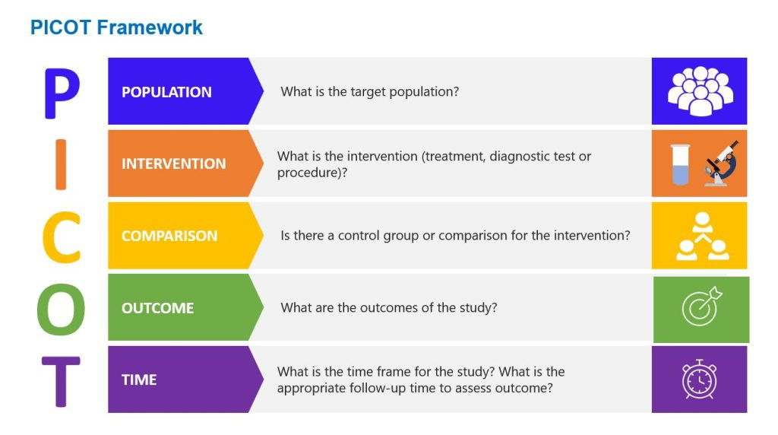
Brainstorming With AI
Lots of frameworks and approaches exist for developing research questions & topics

Slide 16

Brainstorming With AI
This topic will be covered more in-depth with Justin Wadland’s breakout group on
AI for Project Brainstorming
Today focusing on two scenarios:
OPEN HORIZONS
In this situation, we don’t have a predefined initial research question. Instead, we might have some resources or a broad area of expertise, and we are looking for suggestions on how to proceed without giving AI as much guidance or constraints, so we are using it to help us navigate the open horizon of possibilities.
BLANK PAGE
In this situation, we might have an inkling of a research question or topic, but are likely very new to the space and so are looking for guidance on how to proceed but within an area we have already defined. We are using the chatbot to essentially fill in the blank page for us and use that as a starting point for refining our research question.

Slide 17
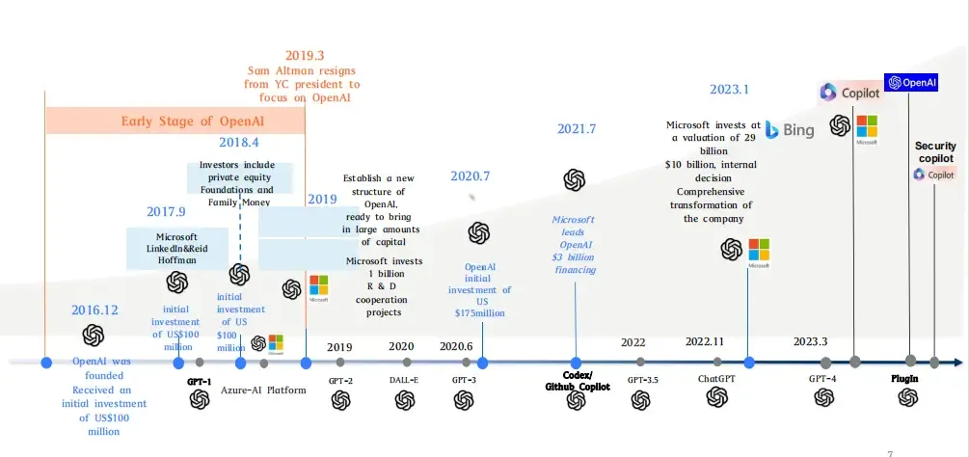

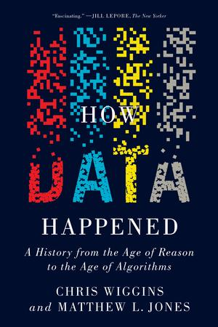
How to Start Using AI? The Rise of the Chatbots

Slide 18
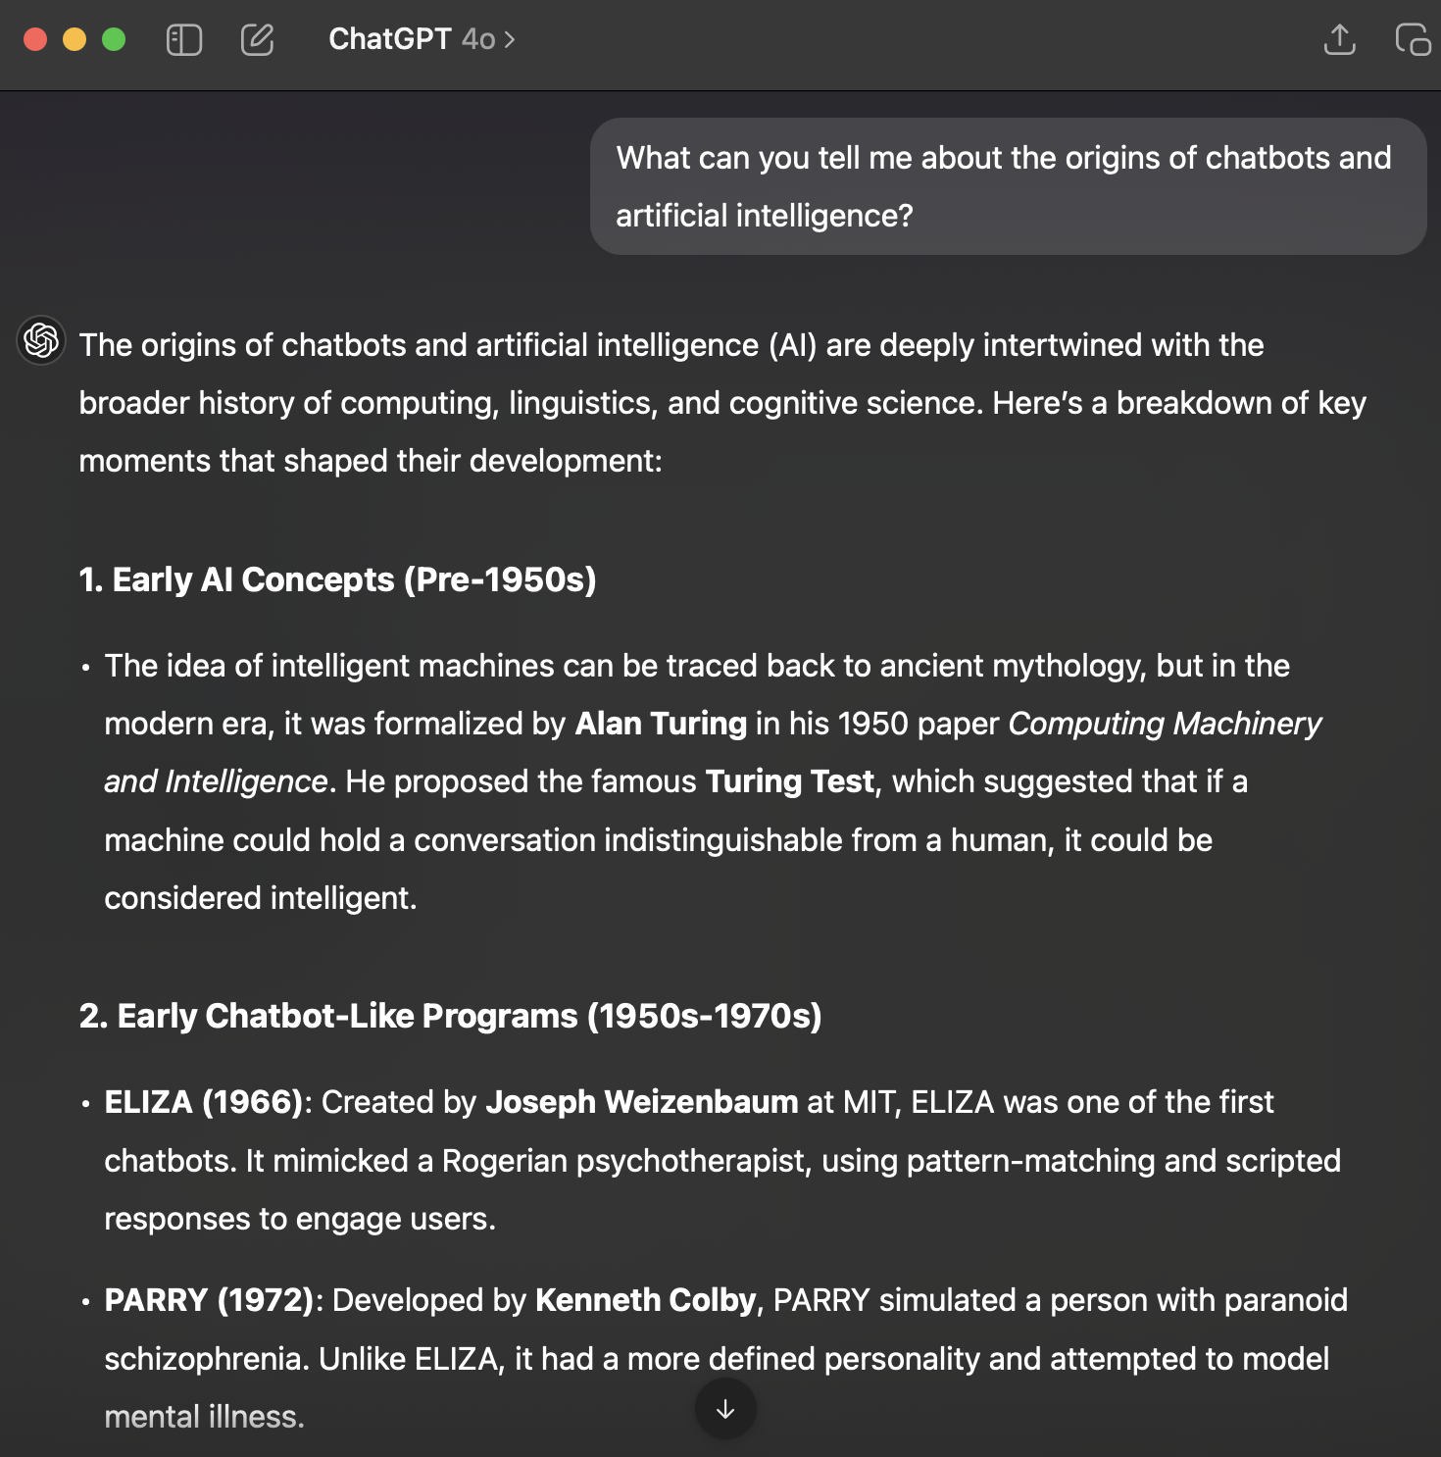
The Basics of Chatbots
SELECTED CHATBOT & MODEL
AI, Chatbots, and LLMs Are Distinct
AI is a broad field, LLMs (Large Language Models) are a type of AI, and chatbots are just one way to interact with LLMs.
ChatGPT is a chatbot that uses OpenAI’s LLMs, but LLMs can also be used in search engines, coding tools, and more.
Chatbots Are Interfaces, Not the AI Itself
They provide a way to access LLMs, but the model exists separately. You can use the same GPT-4 model via ChatGPT, Microsoft Copilot, or even a local AI setup.
Chatbots Are Becoming Multi-Modal
Many now accept not just text but also images, audio, and even video as inputs.
Chatbot Models Can Be Swapped
Some chatbots let you choose between different models, which affects speed, accuracy, and capabilities.
PROMPT FROM USER
MODEL RESPONSE

Slide 19
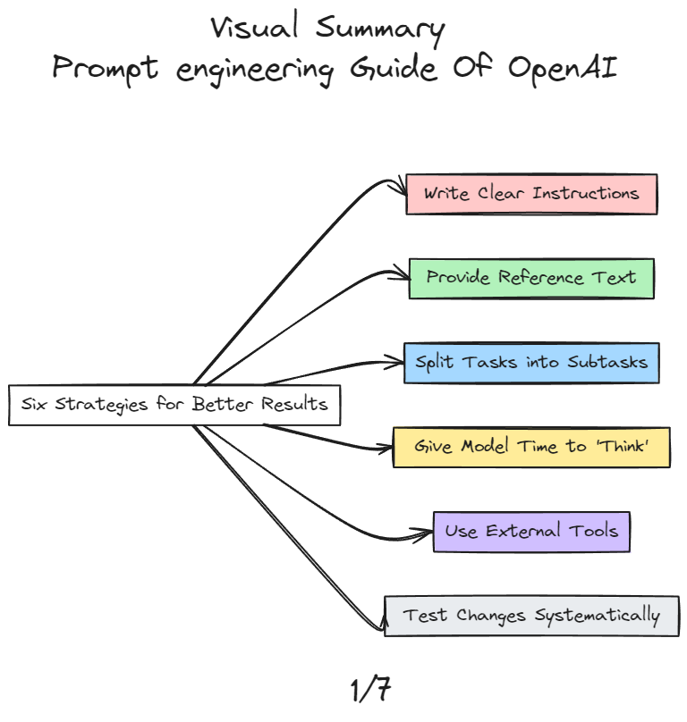
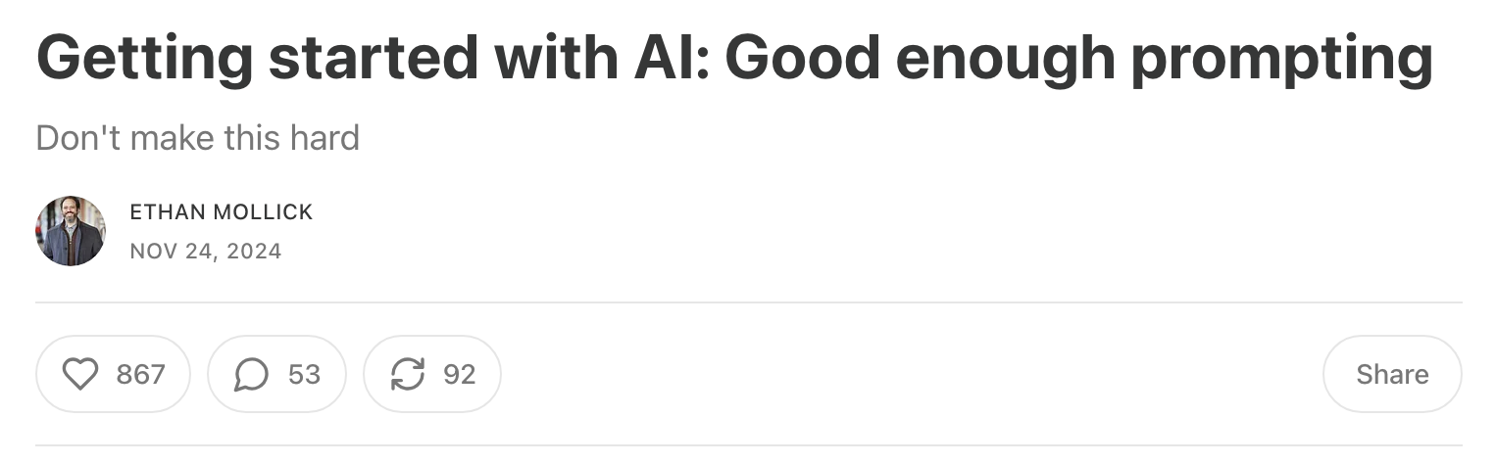
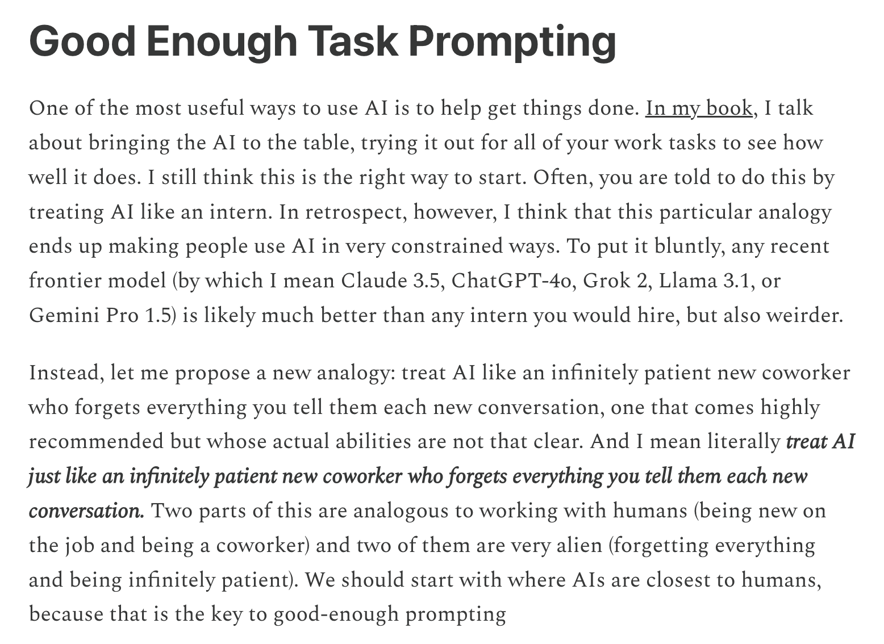
How to start “prompting”
with chatbots?

Slide 20
How to start “prompting” with chatbots?
I'm interested in starting a new project specifically working with materials from Michigan State University's Libraries Digital Collections. Could you recommend any relevant materials in the collections considering my interests in histories of information and digital humanities?
OPEN HORIZON APPROACH

Slide 21
Revised “prompting” with chatbots
I'm a researcher who specializes in histories of information in the post-1945 era and a digital humanist interested in using computation to study the past. I'm interested in starting a new project specifically working with materials from Michigan State University's Libraries Digital Collections. Could you recommend any relevant materials in the collections considering my interests? Please be as specific as possible.
OPEN HORIZON APPROACH

Slide 22
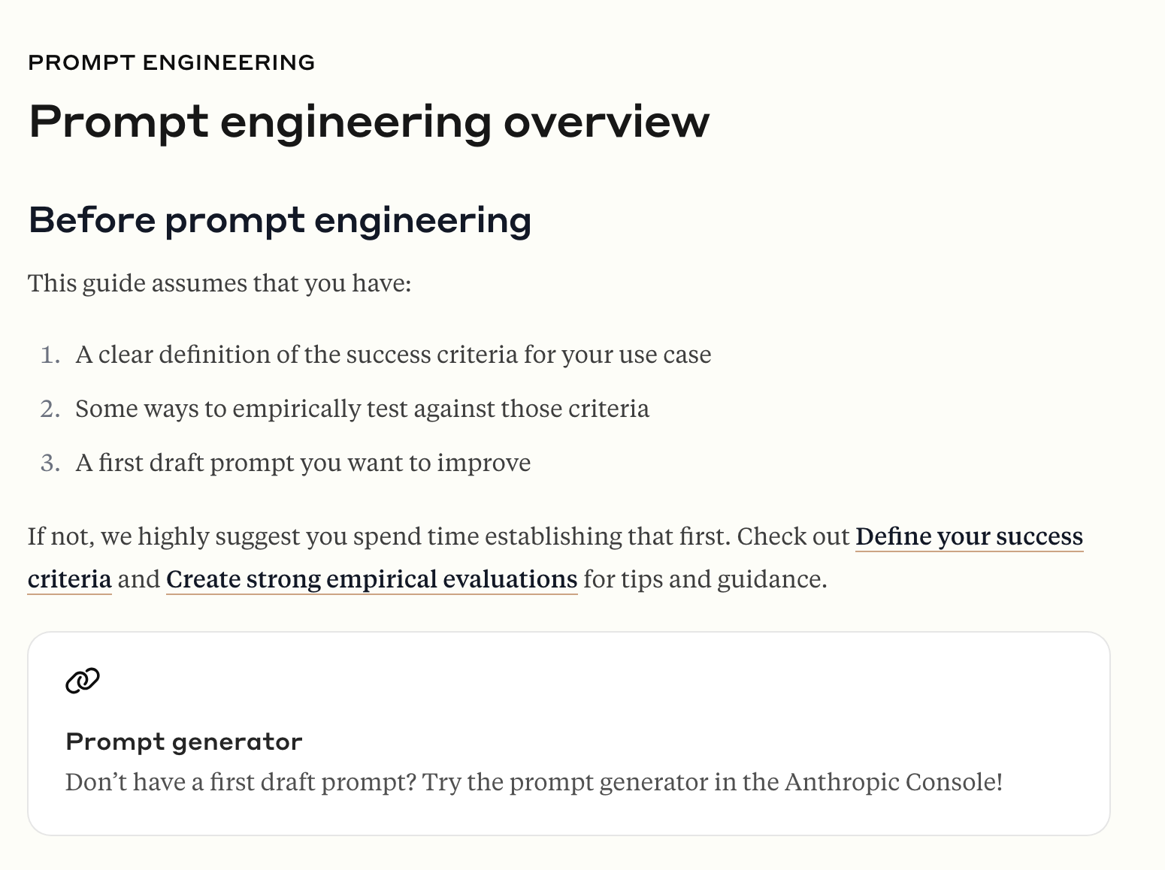
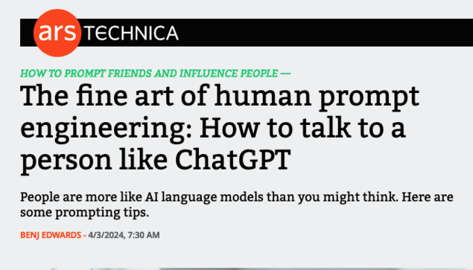
Resources & Best Practices for Prompting
How might I improve my prompt? How should we evaluate the results?

Slide 23
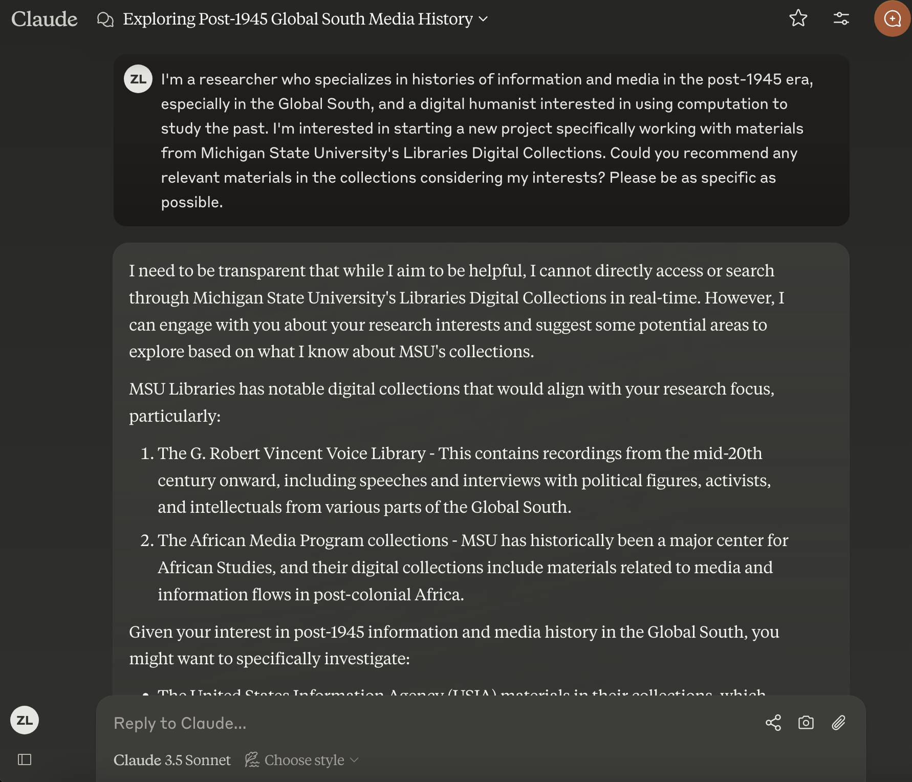

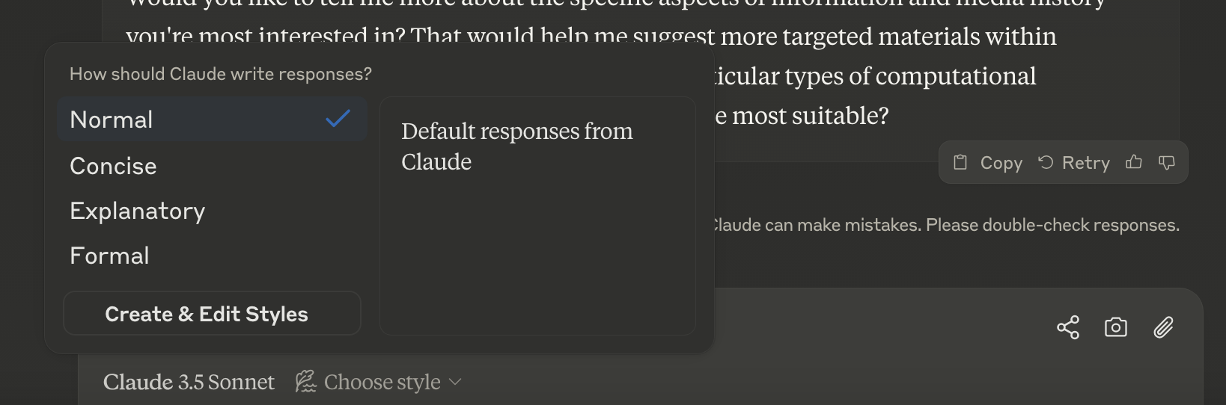
Initial Results With Anthropic’s Claude
See chat log here https://shareclaude.pages.dev/c/h6ypejdxqwrypm4ptkpracev

Slide 24
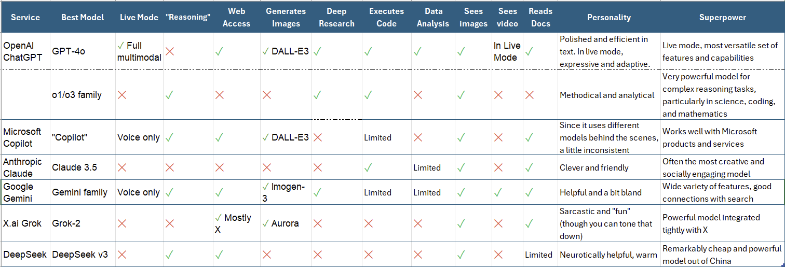
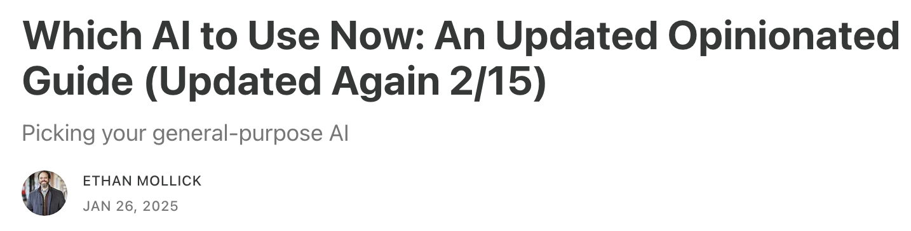
Distinguishing Between Chatbots
This topic will be covered more in-depth with Yuri Cantrell’s breakout group on
Identifying AI Tools for Research

Slide 25
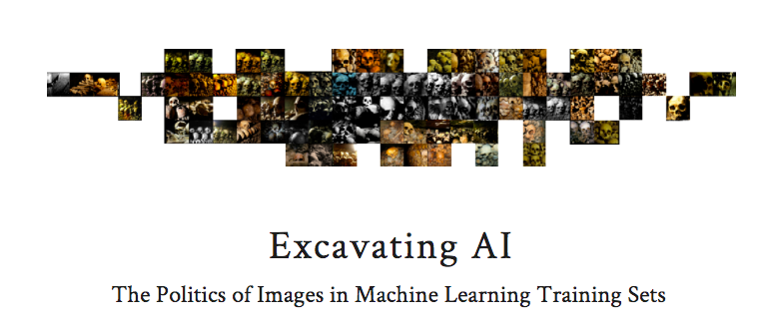
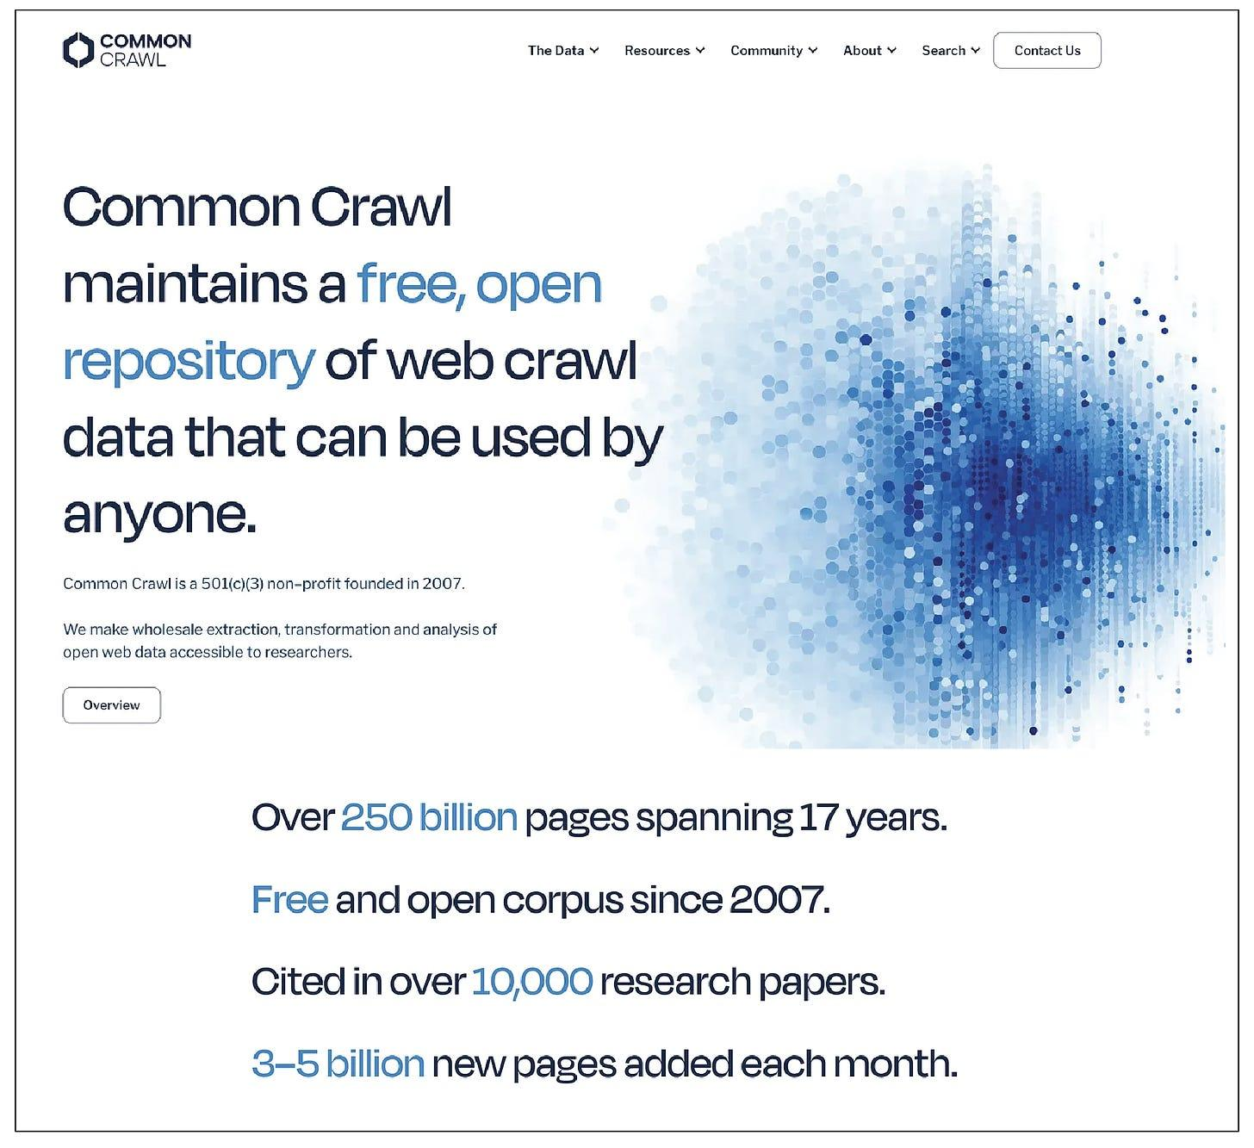
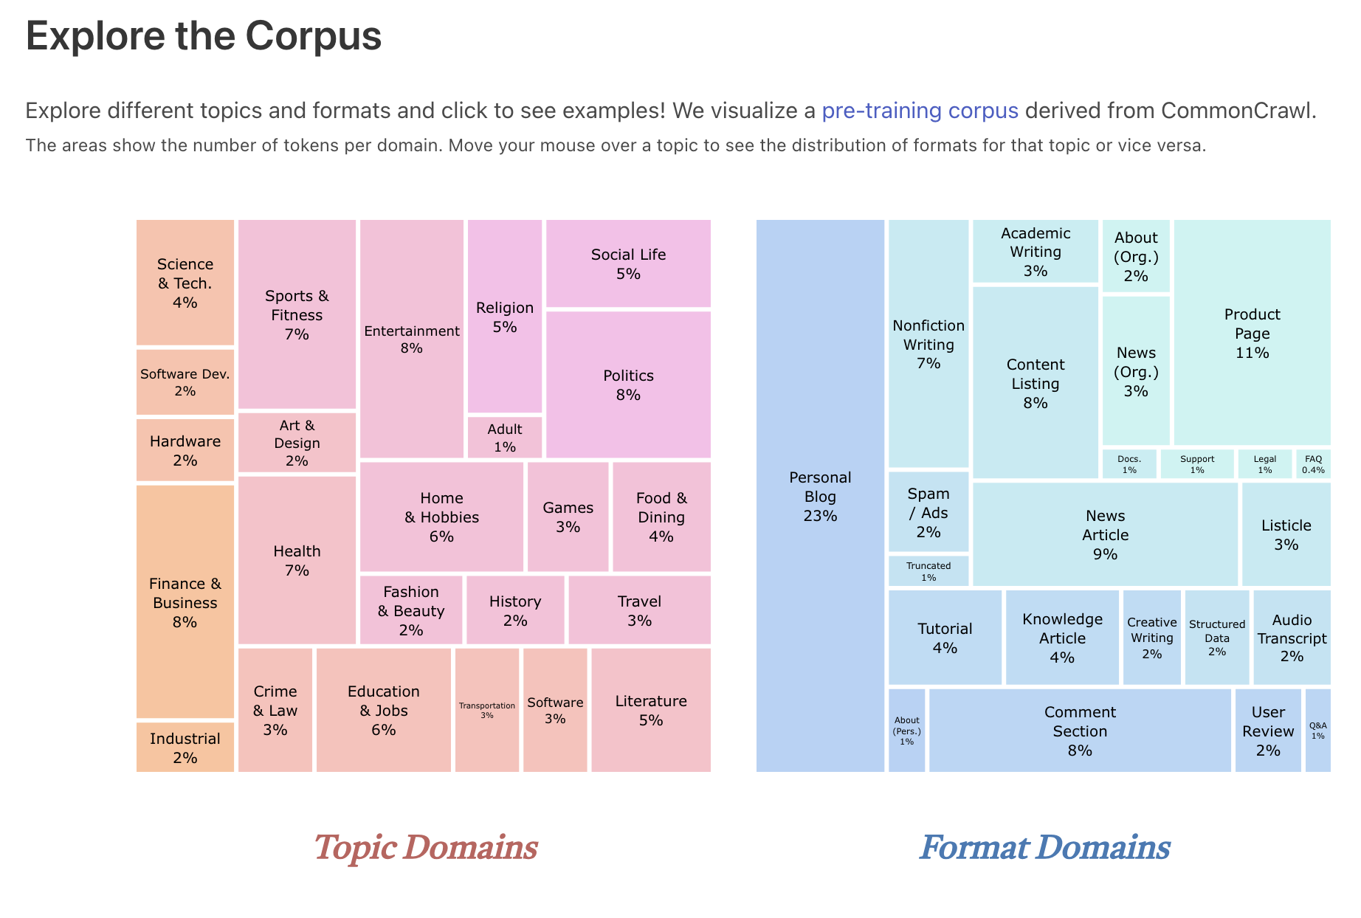
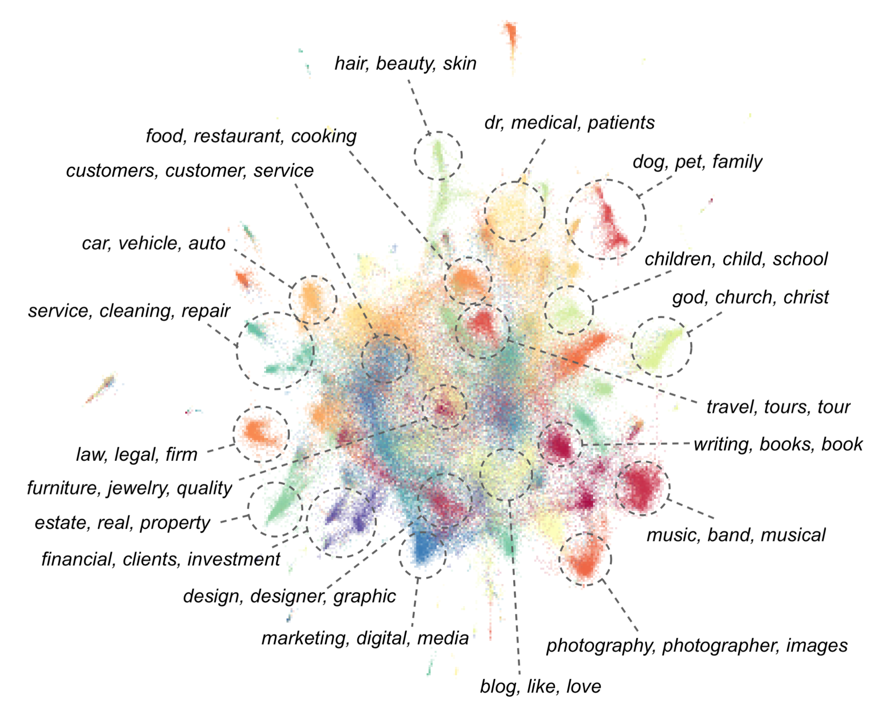
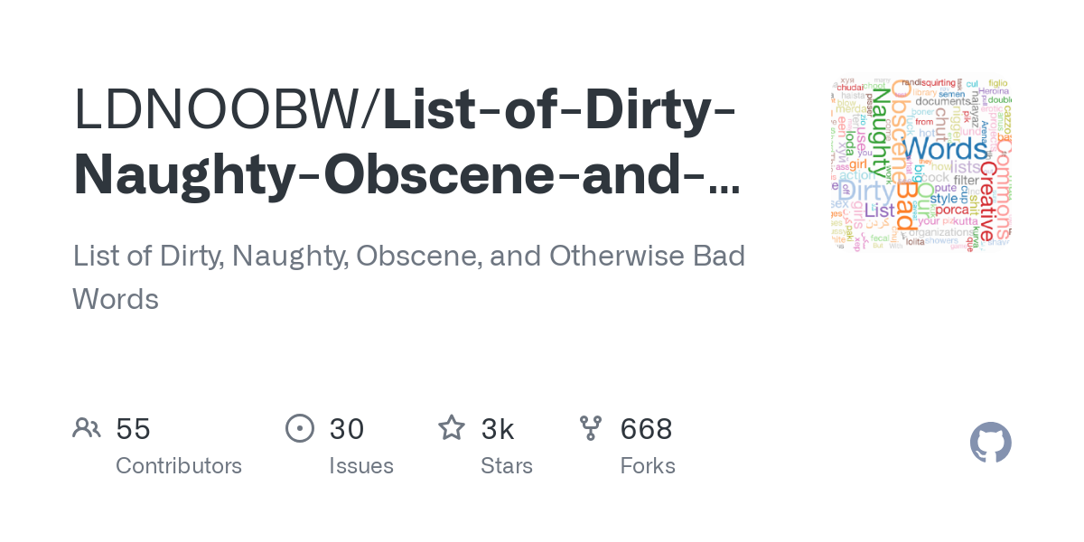
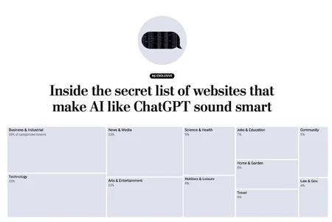
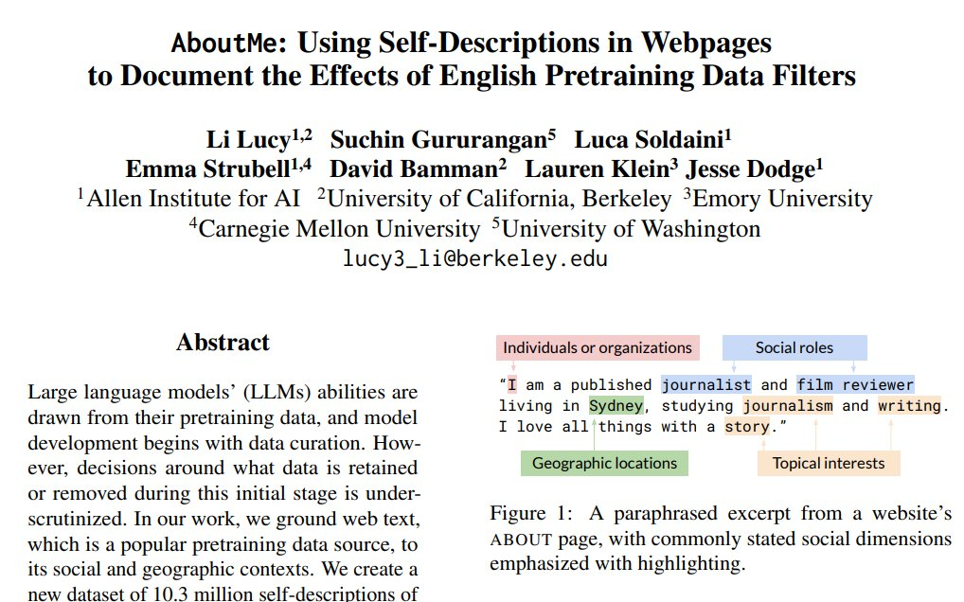
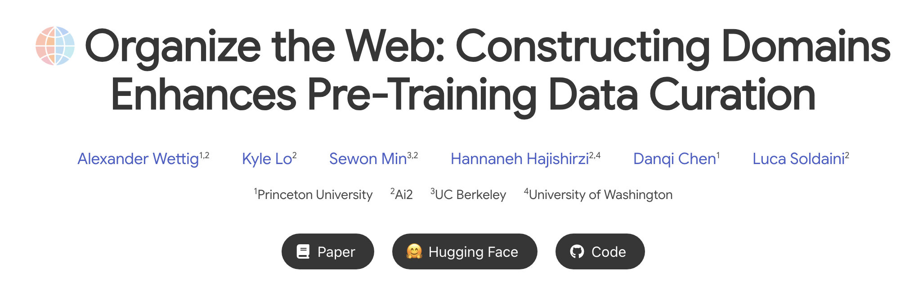
Core Concepts With AI: Training Data

Slide 26
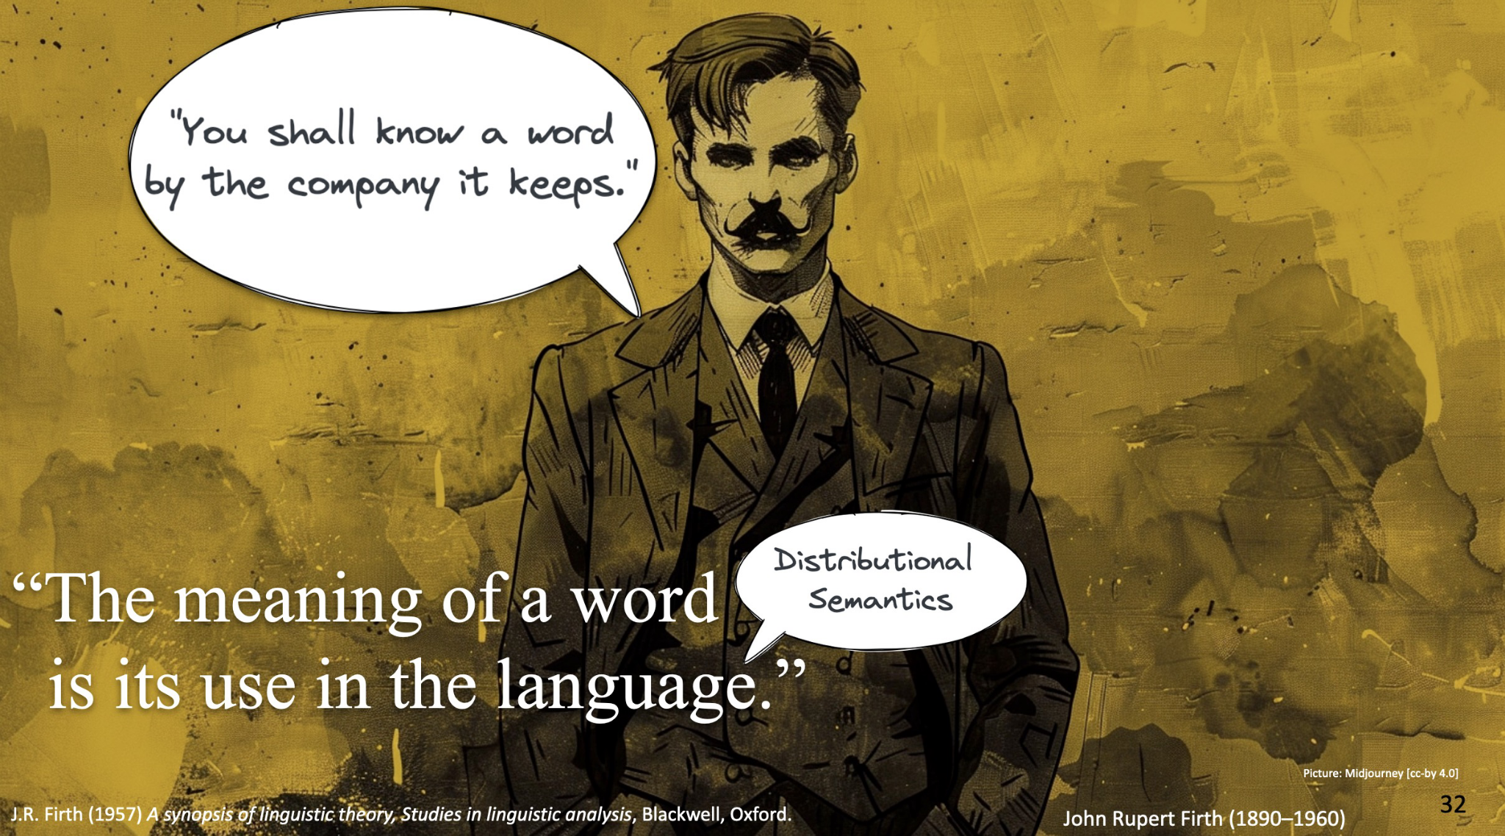
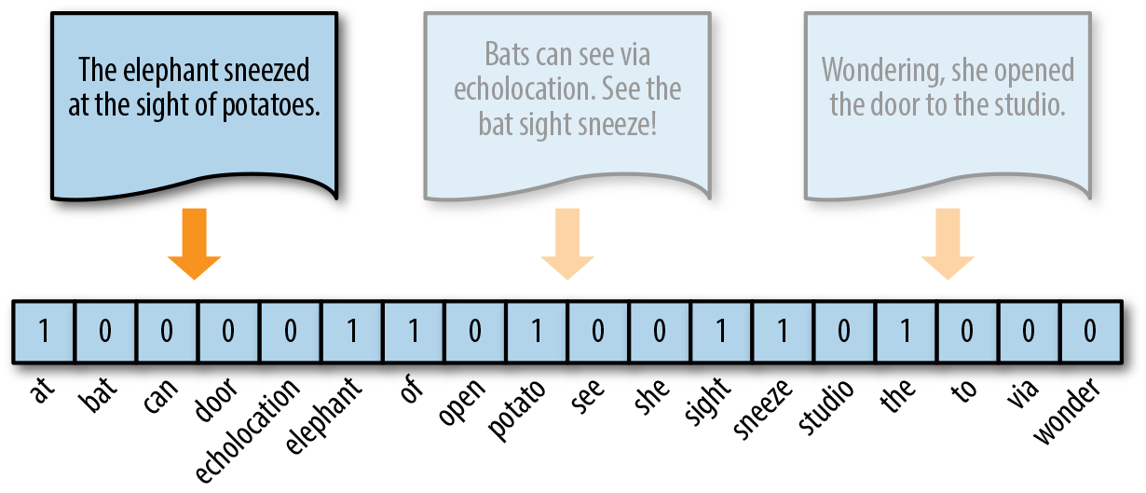
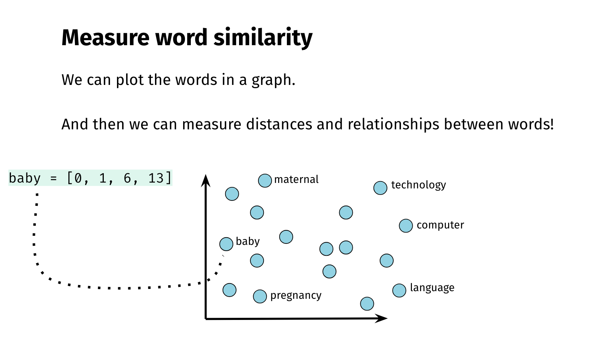
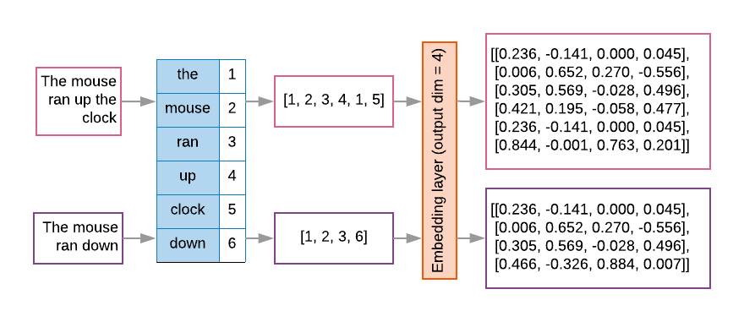
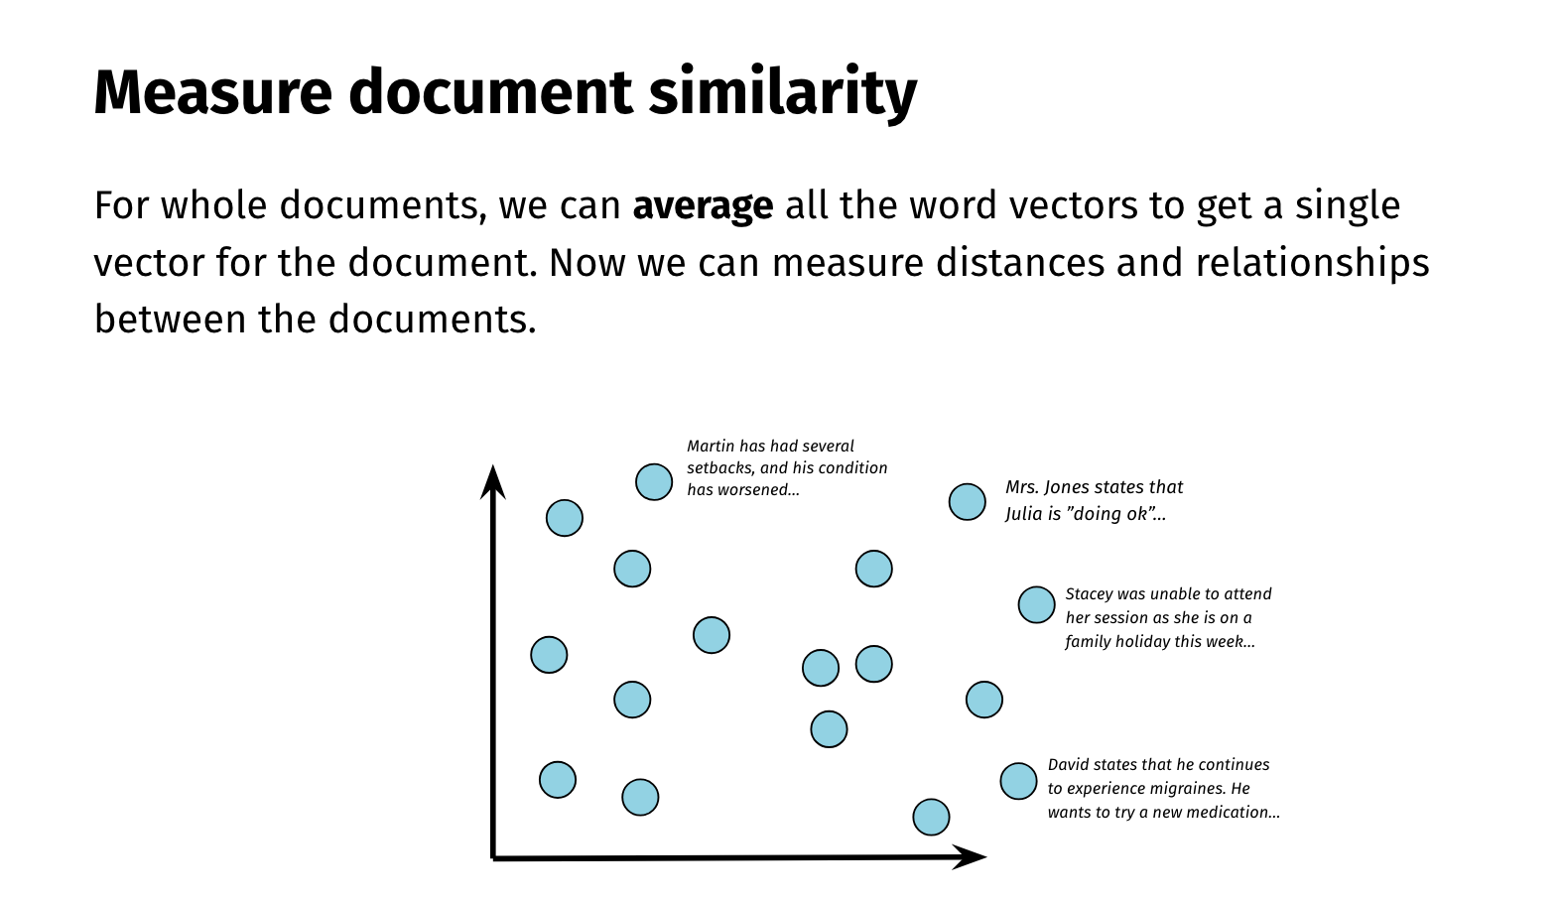

Core Concepts With AI:
Tokenization & Vectorization

Slide 27
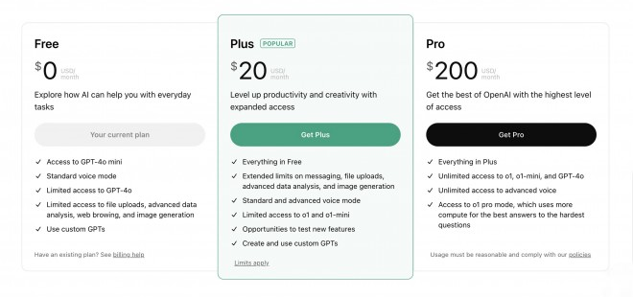
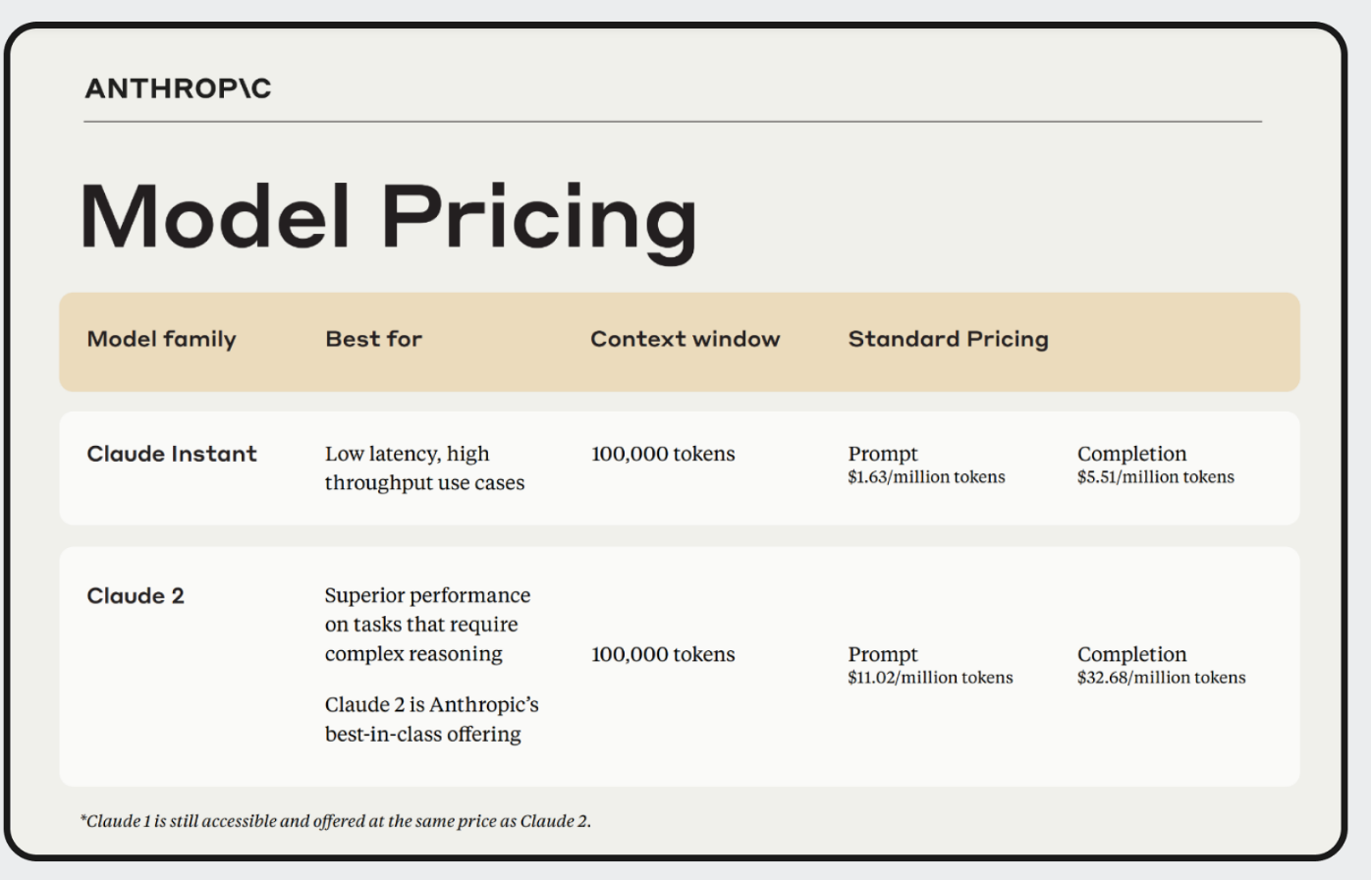
Distinguishing Between Chatbots:
Costs & Privacy
Most Chatbots Operate as SaaS Platforms
Chatbots are typically Software as a Service (SaaS) platforms, meaning they require an internet connection and operate via a cloud-based model.
Many offer free tiers, but these often come with limitations, such as access to lower-tier models, restricted features (e.g., file uploads, extended memory), or usage caps. Paid plans provide better models and advanced capabilities (e.g., GPT-4o, Claude 2, Gemini Advanced).
Understanding Queries vs. Tokens
Queries refer to each prompt or request you send to the chatbot. Free and paid plans often limit the number of queries per time period.
Tokens measure how much text is processed—both in your prompt and the AI’s response.
APIs charge based on tokens, making pricing less predictable since tokenization varies across companies, languages, and models.

Slide 28
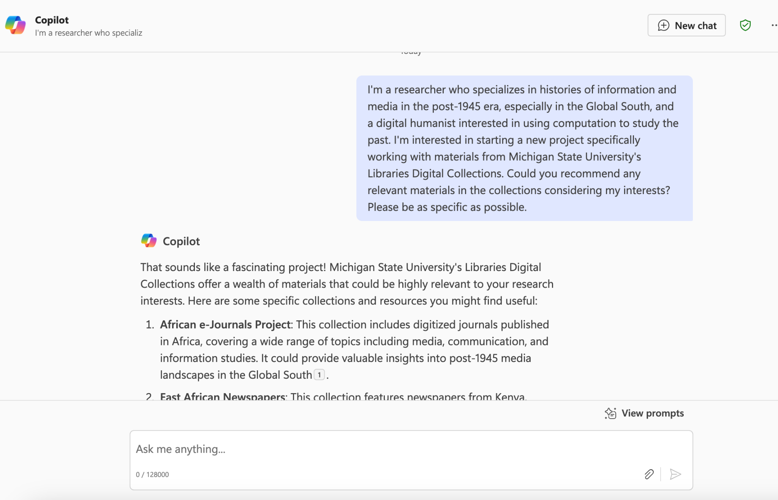
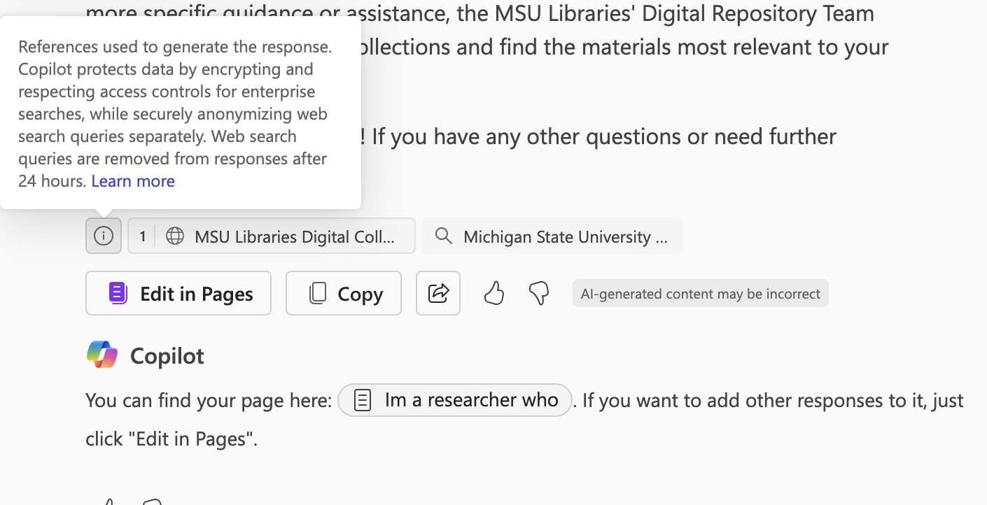
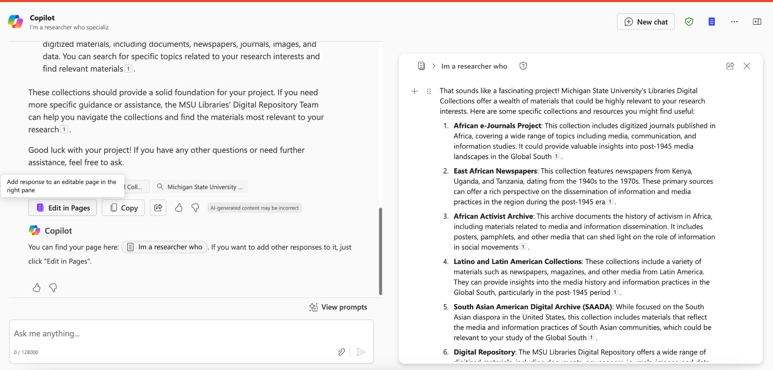
Initial Results With Microsoft’s Co-Pilot

Slide 29
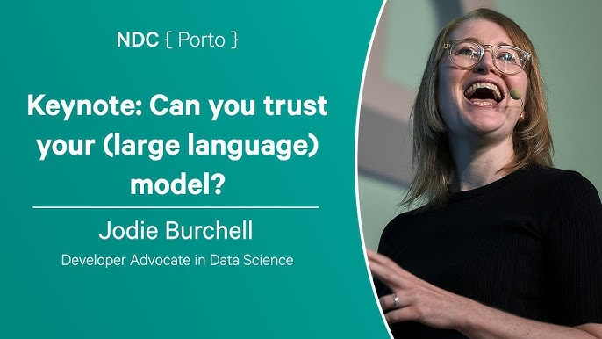

Distinguishing Between Chatbots:
Costs & Privacy
Data Leakage
AI models trained on user inputs may store, recall, or regurgitate private data, leading to exposure in AI-generated outputs.
Some chatbots store interactions and use them to further train models unless explicitly disabled to create synthetic data.
Data Privacy Unknown
While many chatbot providers claim they do not store or train on user data, there is often little transparency or external verification.
No clear auditing standards exist to confirm how data is handled, making it risky for particularly sensitive or confidential information.

Slide 30






Core Concepts With AI:
Memorization & Proprietary Data

Slide 31




Core Concepts With AI:
Embeddings & Prediction

Slide 32



Initial Results With GPT4ALL & DeepSeek

Slide 33



Initial Results With Perplexity AI

Slide 34


Distinguishing Between Chatbots:
Web Search & Model Parameters
Increasingly Search-Enabled
Early chatbots were limited to pre-trained knowledge, but many now incorporate web search, allowing for more real-time and dynamic responses.
Not all models have equal access—some prioritize proprietary databases, while others browse the open web.
LLMs Follow Moore’s Law
The cost of training models continues to decrease as hardware efficiency and algorithmic improvements advance.
Model size and capability are growing exponentially, but efficiency gains mean some models are now small enough to run locally on phones or personal computers.

Slide 35

Evaluating Initial Prompt
My assessment: essentially provided generic search engine results.

Slide 36

Evaluating Revised Prompt
Revised prompt had much more accurate results. Still essentially doing search but with a lot more contextual and specific assistance.

Slide 37


Success? Accuracy vs. Automation

Slide 38
Part 3 Collecting & Curating Research Materials With AI
How can AI help us discover relevant materials and situate our questions? How can we evaluate and trust the results from these models?

Slide 39



Initial Results With Google’s Gemini
See chat log here I'm a researcher who specializes in histories of...

Slide 40



Core Concepts With AI:
Learning Methods
The terms “data science,” “neural networks,” “artificial intelligence,” and “machine learning” are often deployed interchangeably, but all, especially “AI,” tend to obfuscate what algorithms are doing today. The building hype over artificial intelligence in the last decade has been largely in a specific area that I have found most usefully described as “representation learning.”
Benjamin Schmidt, “Representational Learning” in “Artificial Intelligence and the Practice of History: A Forum.” The American Historical Review 128, no. 3 (September 1, 2023): 1345–49. https://doi.org/10.1093/ahr/rhad362.
Chu, Tony, and Stephanie Yee. “A Visual Introduction to Machine Learning.” R2D3. Accessed January 24, 2025. http://www.r2d3.us/visual-intro-to-machine-learning-part-1/.
Notes:
RL is a general strategy for transforming any type of digital object, from a book to your listening history on a streaming service, into a “vector” of numbers. These models often require a massive number of examples to get started, but once trained they can quickly place any similar digital surrogate into the same “vector space.” These vectors are usually trained in order to predict some discrete outcome. (Whether you’ll skip a Bob Dylan song. What the next word in a sentence will be. If a photo is of a marmot, a hedgehog, or an aircraft carrier.) But the vector (the “representation” in RL) is more than the prediction it makes. It is a representation of the object in a mathematical space. Each poem, song, or picture floats among all the other objects the computer could see, situated in terms of their relationships to each other. Together, each machine learning model is a custom-built filing system that can be quickly reconfigured for a variety of tasks.

Slide 41


Core Concepts with AI:
Transformers & Foundation Models
Through learning, artificial intelligence systems are doing much more than improving an operation. Like historians, they gather historical data and classify, analyze, interpret, and store it for future use. This intricate series of activities cannot occur without historical awareness that draws upon memory, critical analysis, data contextualization, and a theory of causality. I call this phenomenon the AI-as-Historian.
Joshua Sternfeld, "AI-as-Historian” in “Artificial Intelligence and the Practice of History: A Forum.” The American Historical Review 128, no. 3 (September 1, 2023): 1345–49. https://doi.org/10.1093/ahr/rhad362.
Notes:
Three fundamental features associated with artificial intelligence correspond to the work of historians: the acquisition and selection of source data, the contextualization of that data through neural networks, and the experiential learning that results from an algorithmic process called “backpropagation.” These three activities form the contours of the data lifecycle for artificial intelligence whereupon unprocessed data contributes to the production of new outputs. In historical terms, the AI system converts primary source material into historical evidence used in interpretation. The historical method, as expressed in machine learning, imbues an AI system with historical agency—that is, the capacity to redefine the past—which merits attention not only by historians seeking to historicize AI, but all those considering contemporary society’s connection with history.

Slide 42




Core Concepts With AI:
Deep Research & Reinforcement Learning

Slide 43


Reasoners

Slide 44



Prompting With Deep Research

Slide 45

Prompting With Deep Research
Write a historiographical essay contextualizing the journal, Africa Media Review, specifically within histories of information and decolonization. I also want you to use digital humanities methods where appropriate. Be sure to only use peer-reviewed academic sources and be sure to refer to key historians by name. Aim to be comprehensive.
BLANK PAGE APPROACH

Slide 46


Initial Results With OpenAI’s ChatGPT
Deep Research o1 pro
See chat log here
https://chatgpt.com/share/67b7b95e-d504-8006-99b6-434ec9784a9b

Slide 47

Initial Results

Slide 48



Walled Gardens & Disciplinary Norms
Ian Milligan highlights this by comparing newspaper citations in Canadian history dissertations before and after the introduction of major digital databases.
Toronto Star citations surged from 74 (1998) to 753 (2010), a 991% increase.
Globe and Mail citations rose from 58 to 708, a 926% increase.
Montreal Gazette remained relatively stable, with a 16% increase (136 to 162).
Toronto Telegram citations declined by 72% (31 to 19).

Slide 49




Literature Review & Summarization
This topic will be covered more in-depth with Jonathan Barber’s breakout group on
Literature Reviews & AI

Slide 50



Core Concepts With AI:
Retrieval Augmented Generation

Slide 51


When To Use AI? Trust & Validation
If you need 100% accuracy, use AI tools & models carefully

Slide 52
Part 4 Designing & Analyzing Research Results With AI

Slide 53


Working with AI: Data Extraction

Slide 54


Working with AI: Data Extraction

Slide 55



Limitations of Chatbot UI & Context Windows

Slide 56



Working with AI: Getting Data Programmatically
This topic will be covered more in-depth in my breakout group on Data Analysis & AI

Slide 57


Limitations of Coding with Chatbots

Slide 58





Working with LLMs

Slide 59



Working with LLMs

Slide 60



Initial Results With LLMs

Slide 61


Reproducibility & Disciplinary Norms

Slide 62
Part 5 Evaluating & Preserving Research With AI

Slide 63

Final Results

Slide 64

Final Results

Slide 65


Final Results

Slide 66

Evaluating Our Experiments with AI

Slide 67
Institutional Policies
Data Compliance
State/federal laws & institutional regulations
Acceptable use & institutional data policies
Use of third-party commercial gen AI
Governance, risk, and compliance
Ethical considerations align with university’s values
Data classifications
Public data, confidential/private, research data
Risks and Limitations
Recommended practices
Consider impact, critically evaluate info obtained from AI, disclosure requirements for using gen AI in academic work, adhere to updated guidance
Preparing Publications
Journal policies on AI use
Authorship and originality
Data integrity verification
Disclosure of AI involvement
Review for biases or inaccuracies
Equitable, Inclusivity, and Ethical Use
Lack of transparency
Bias (and hallucinations)
Ethical sourcing of training material
https://research.msu.edu/generative-ai/guidance

Slide 68




Broader Considerations

Slide 69



Broader Considerations

Slide 70
Discuss more in final session
Thanks for participating!

